Slide 1

Firebase
DR JOSE ANNUNZIATO

Slide 2
Realtime
Instead of typical HTTP requests, the Firebase Realtime Database uses data synchronization
Every time data changes, any connected device receives that update within milliseconds
Provide collaborative and immersive experiences without thinking about networking code

Slide 3
Offline
Firebase apps remain responsive even when offline
Firebase Realtime Database SDK persists data to disk
Once connectivity is reestablished, client device receives any missed changes
Synchronizing it with the current server state

Slide 4
Accessible from Client Devices
Firebase Realtime Database can be accessed directly from a mobile device or web browser
No need for an application server
Security and data validation are available through the Firebase Realtime Database Security Rules
Expression-based rules that are executed when data is read or written.

Slide 5
Authentication
Flexible, expression-based rules language to define how data should be structured
And when data can be read from or written to
When integrated with Firebase Authentication, developers can define who has access to what data
And how they can access it

Slide 6
NoSQL
Different optimizations and functionality compared to a relational database
API designed to only allow operations that can be executed quickly
It is important to think about how users need to access your data and then structure it accordingly.

Slide 7
SETTING UP
FIRESTORE
& NODE.JS

Slide 8
Creating a Firebase Database

Slide 9
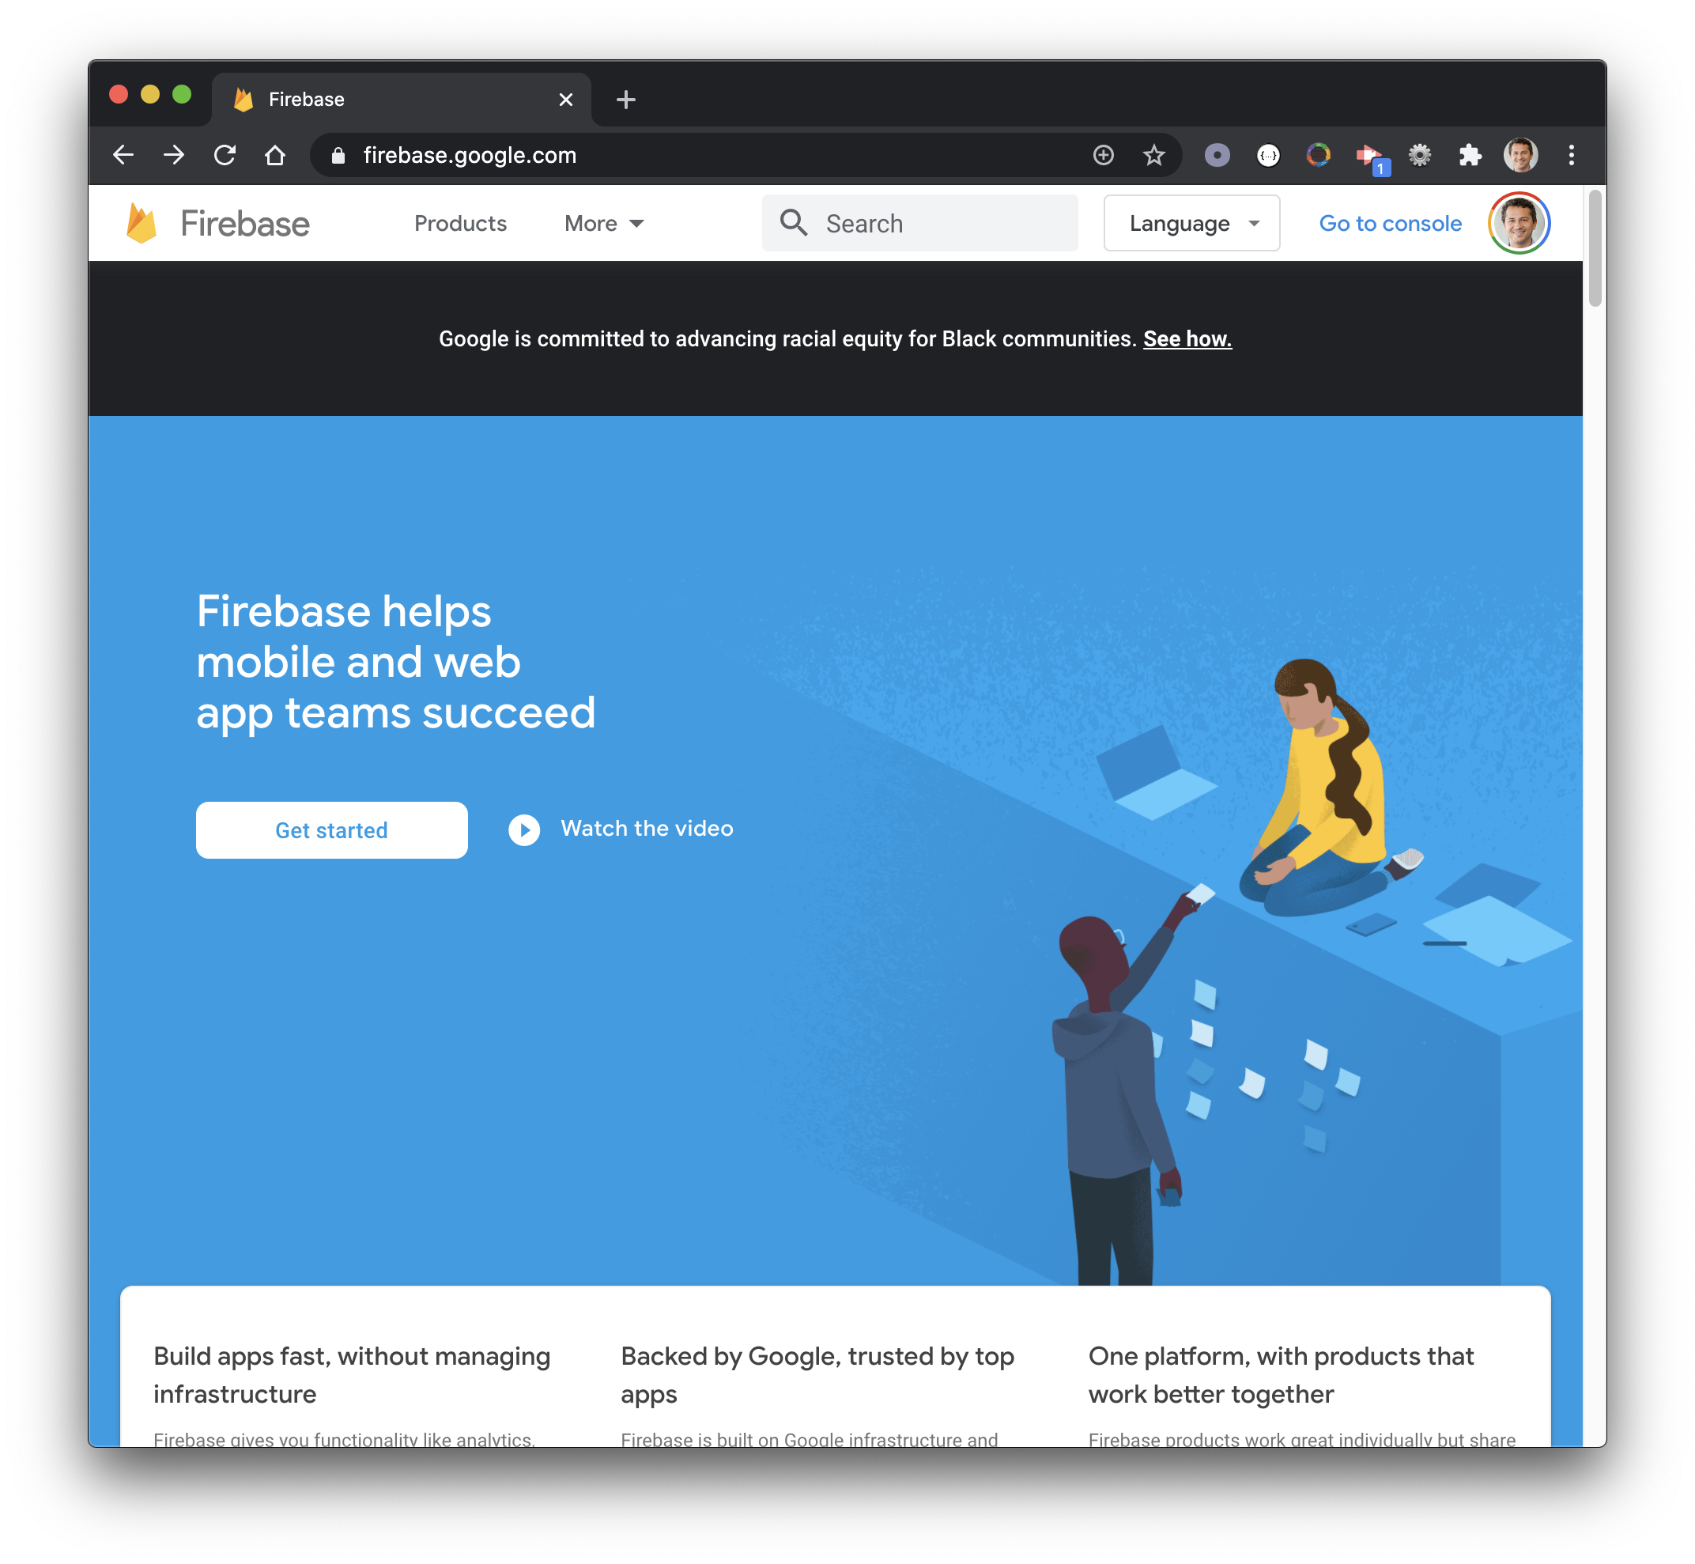
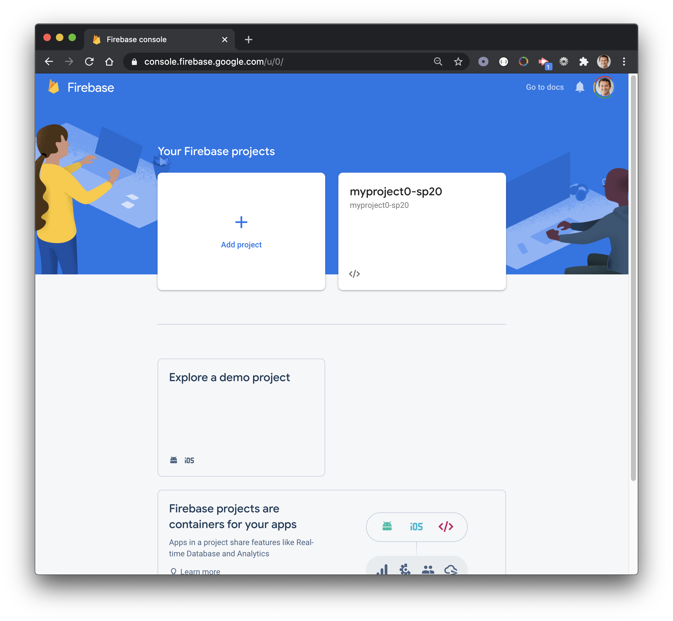
Navigate to firebase.google.com
Get Started
Add project
1
2
3

Slide 10
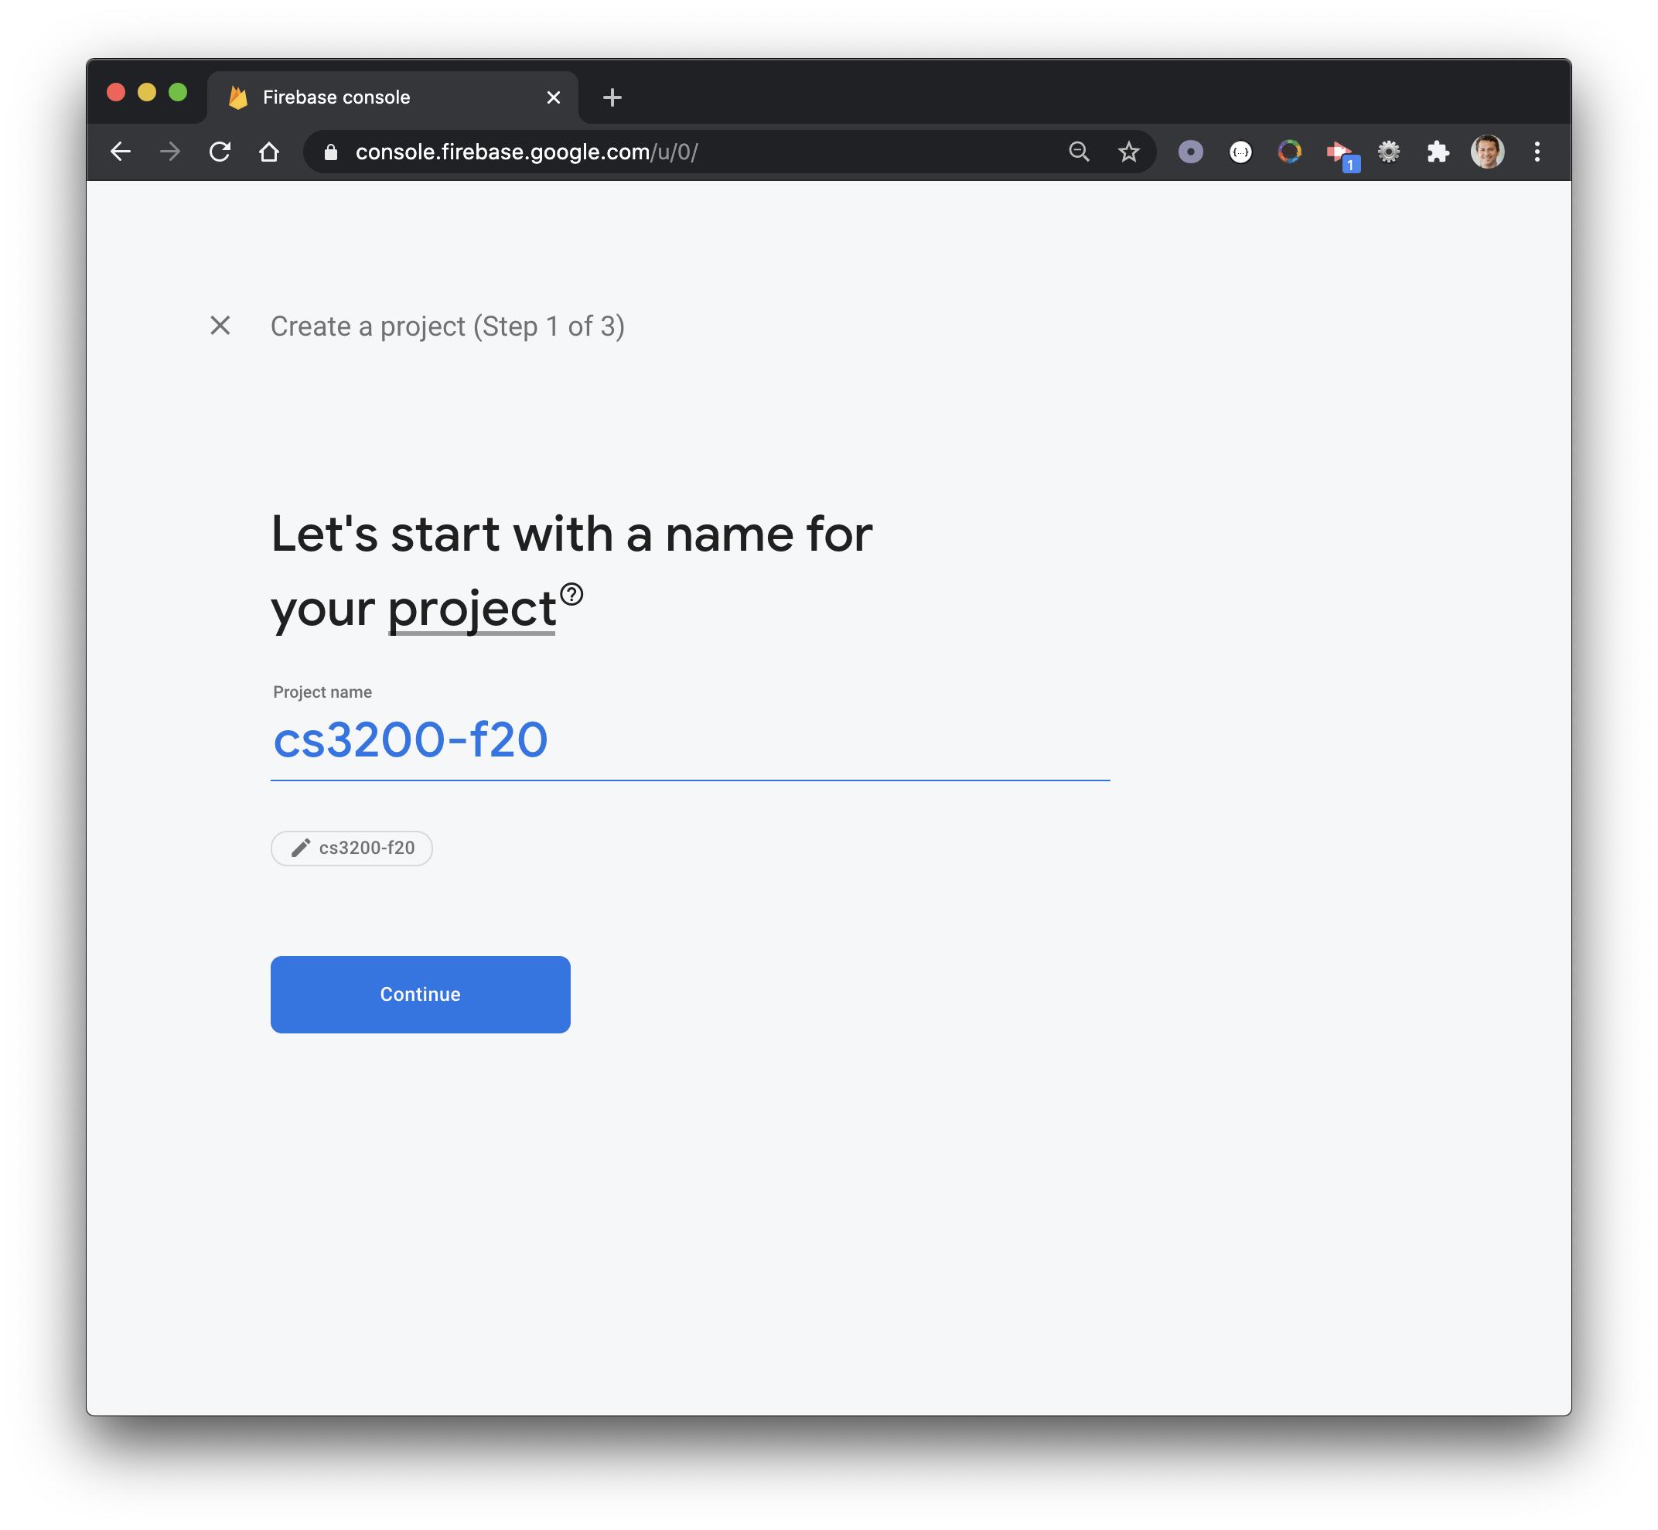
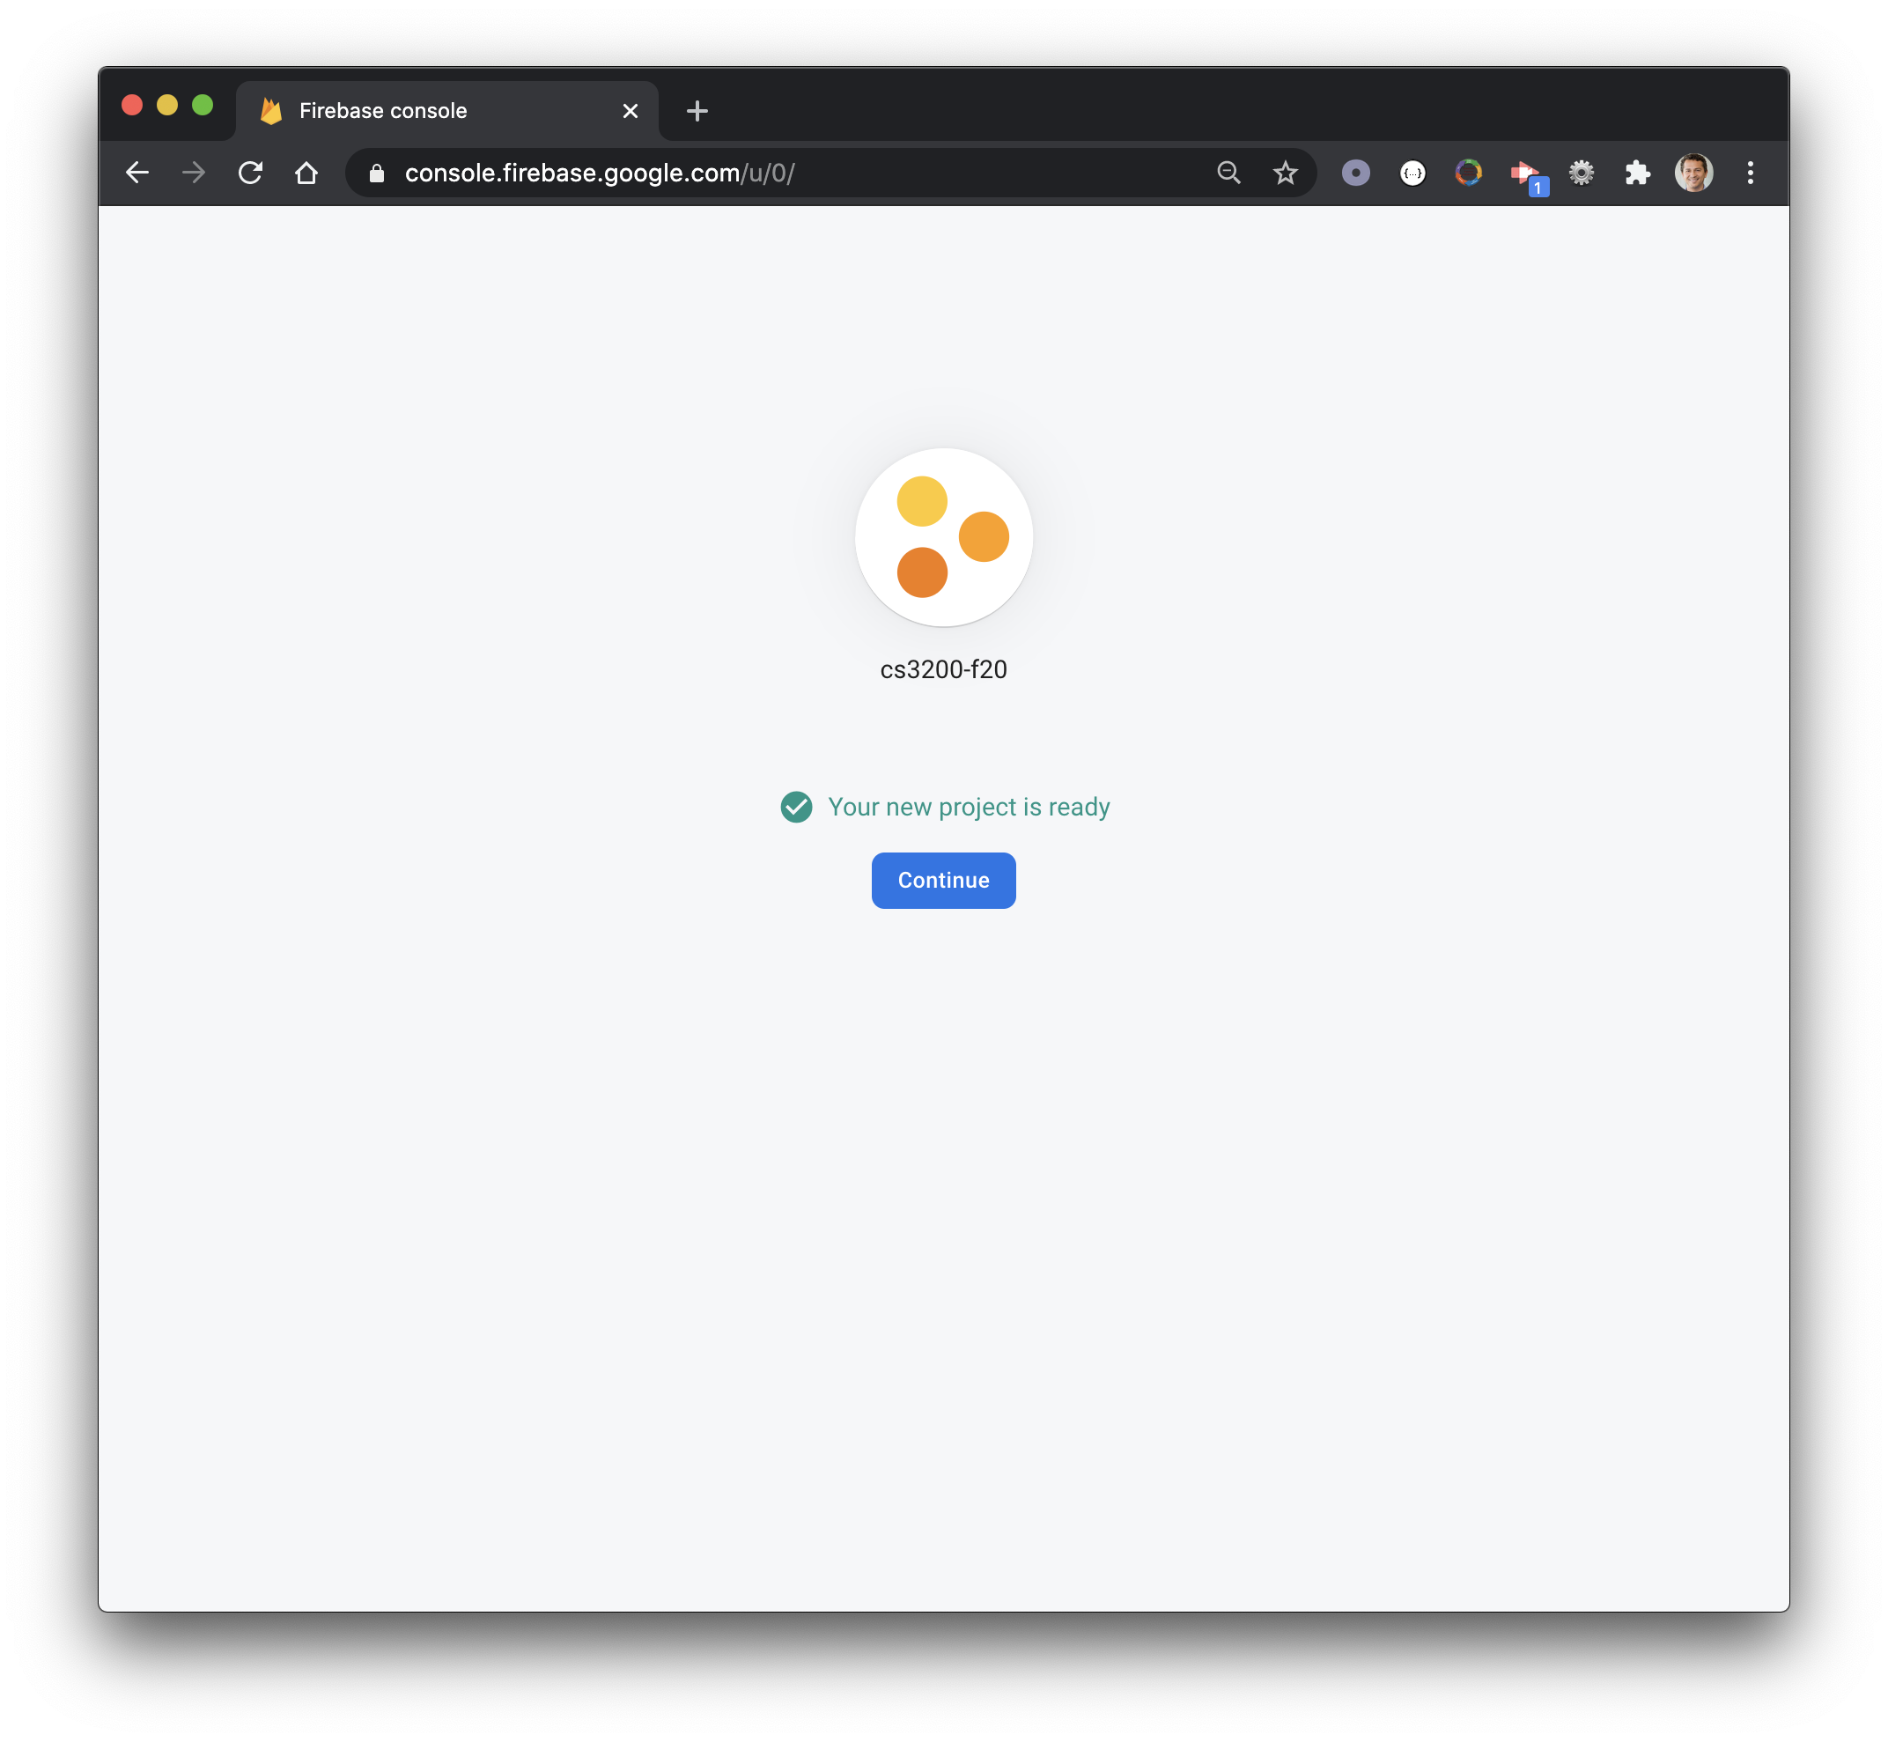
Name your project
Continue
Continue
1
2
3

Slide 11
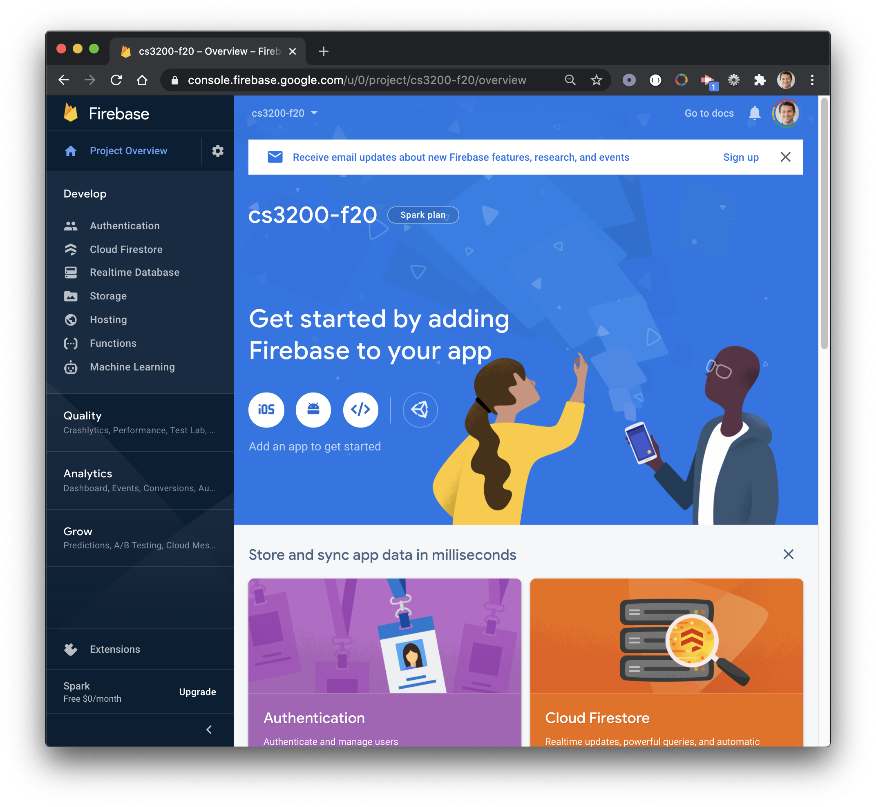
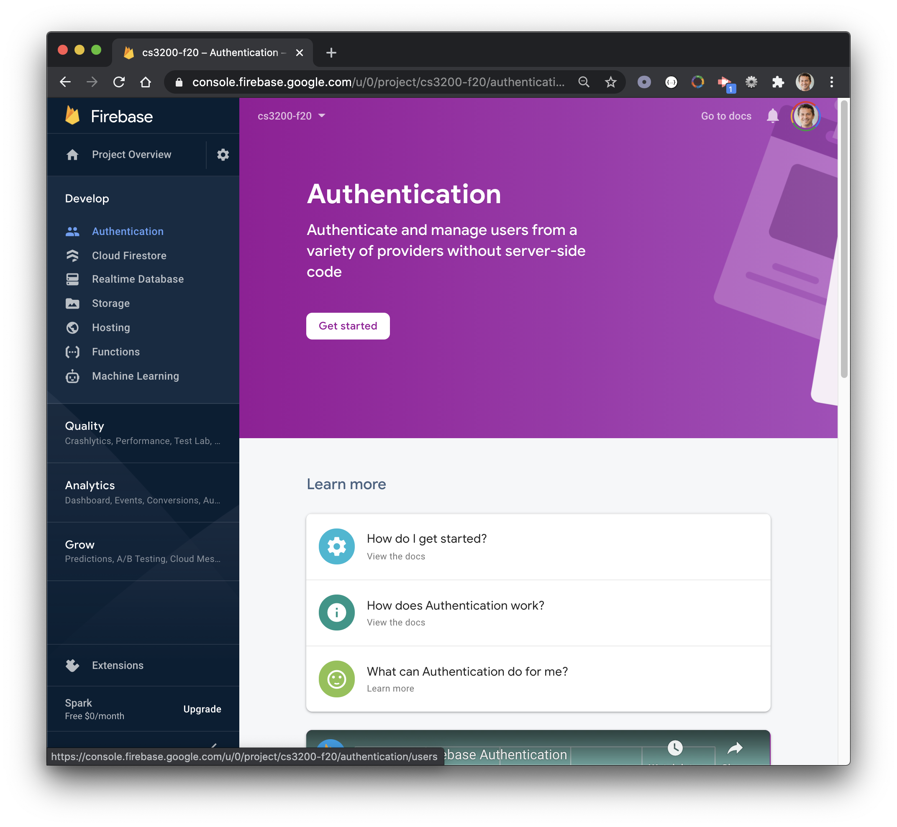
console.firebase...
Project Overview
Authentication
1
2

Slide 12
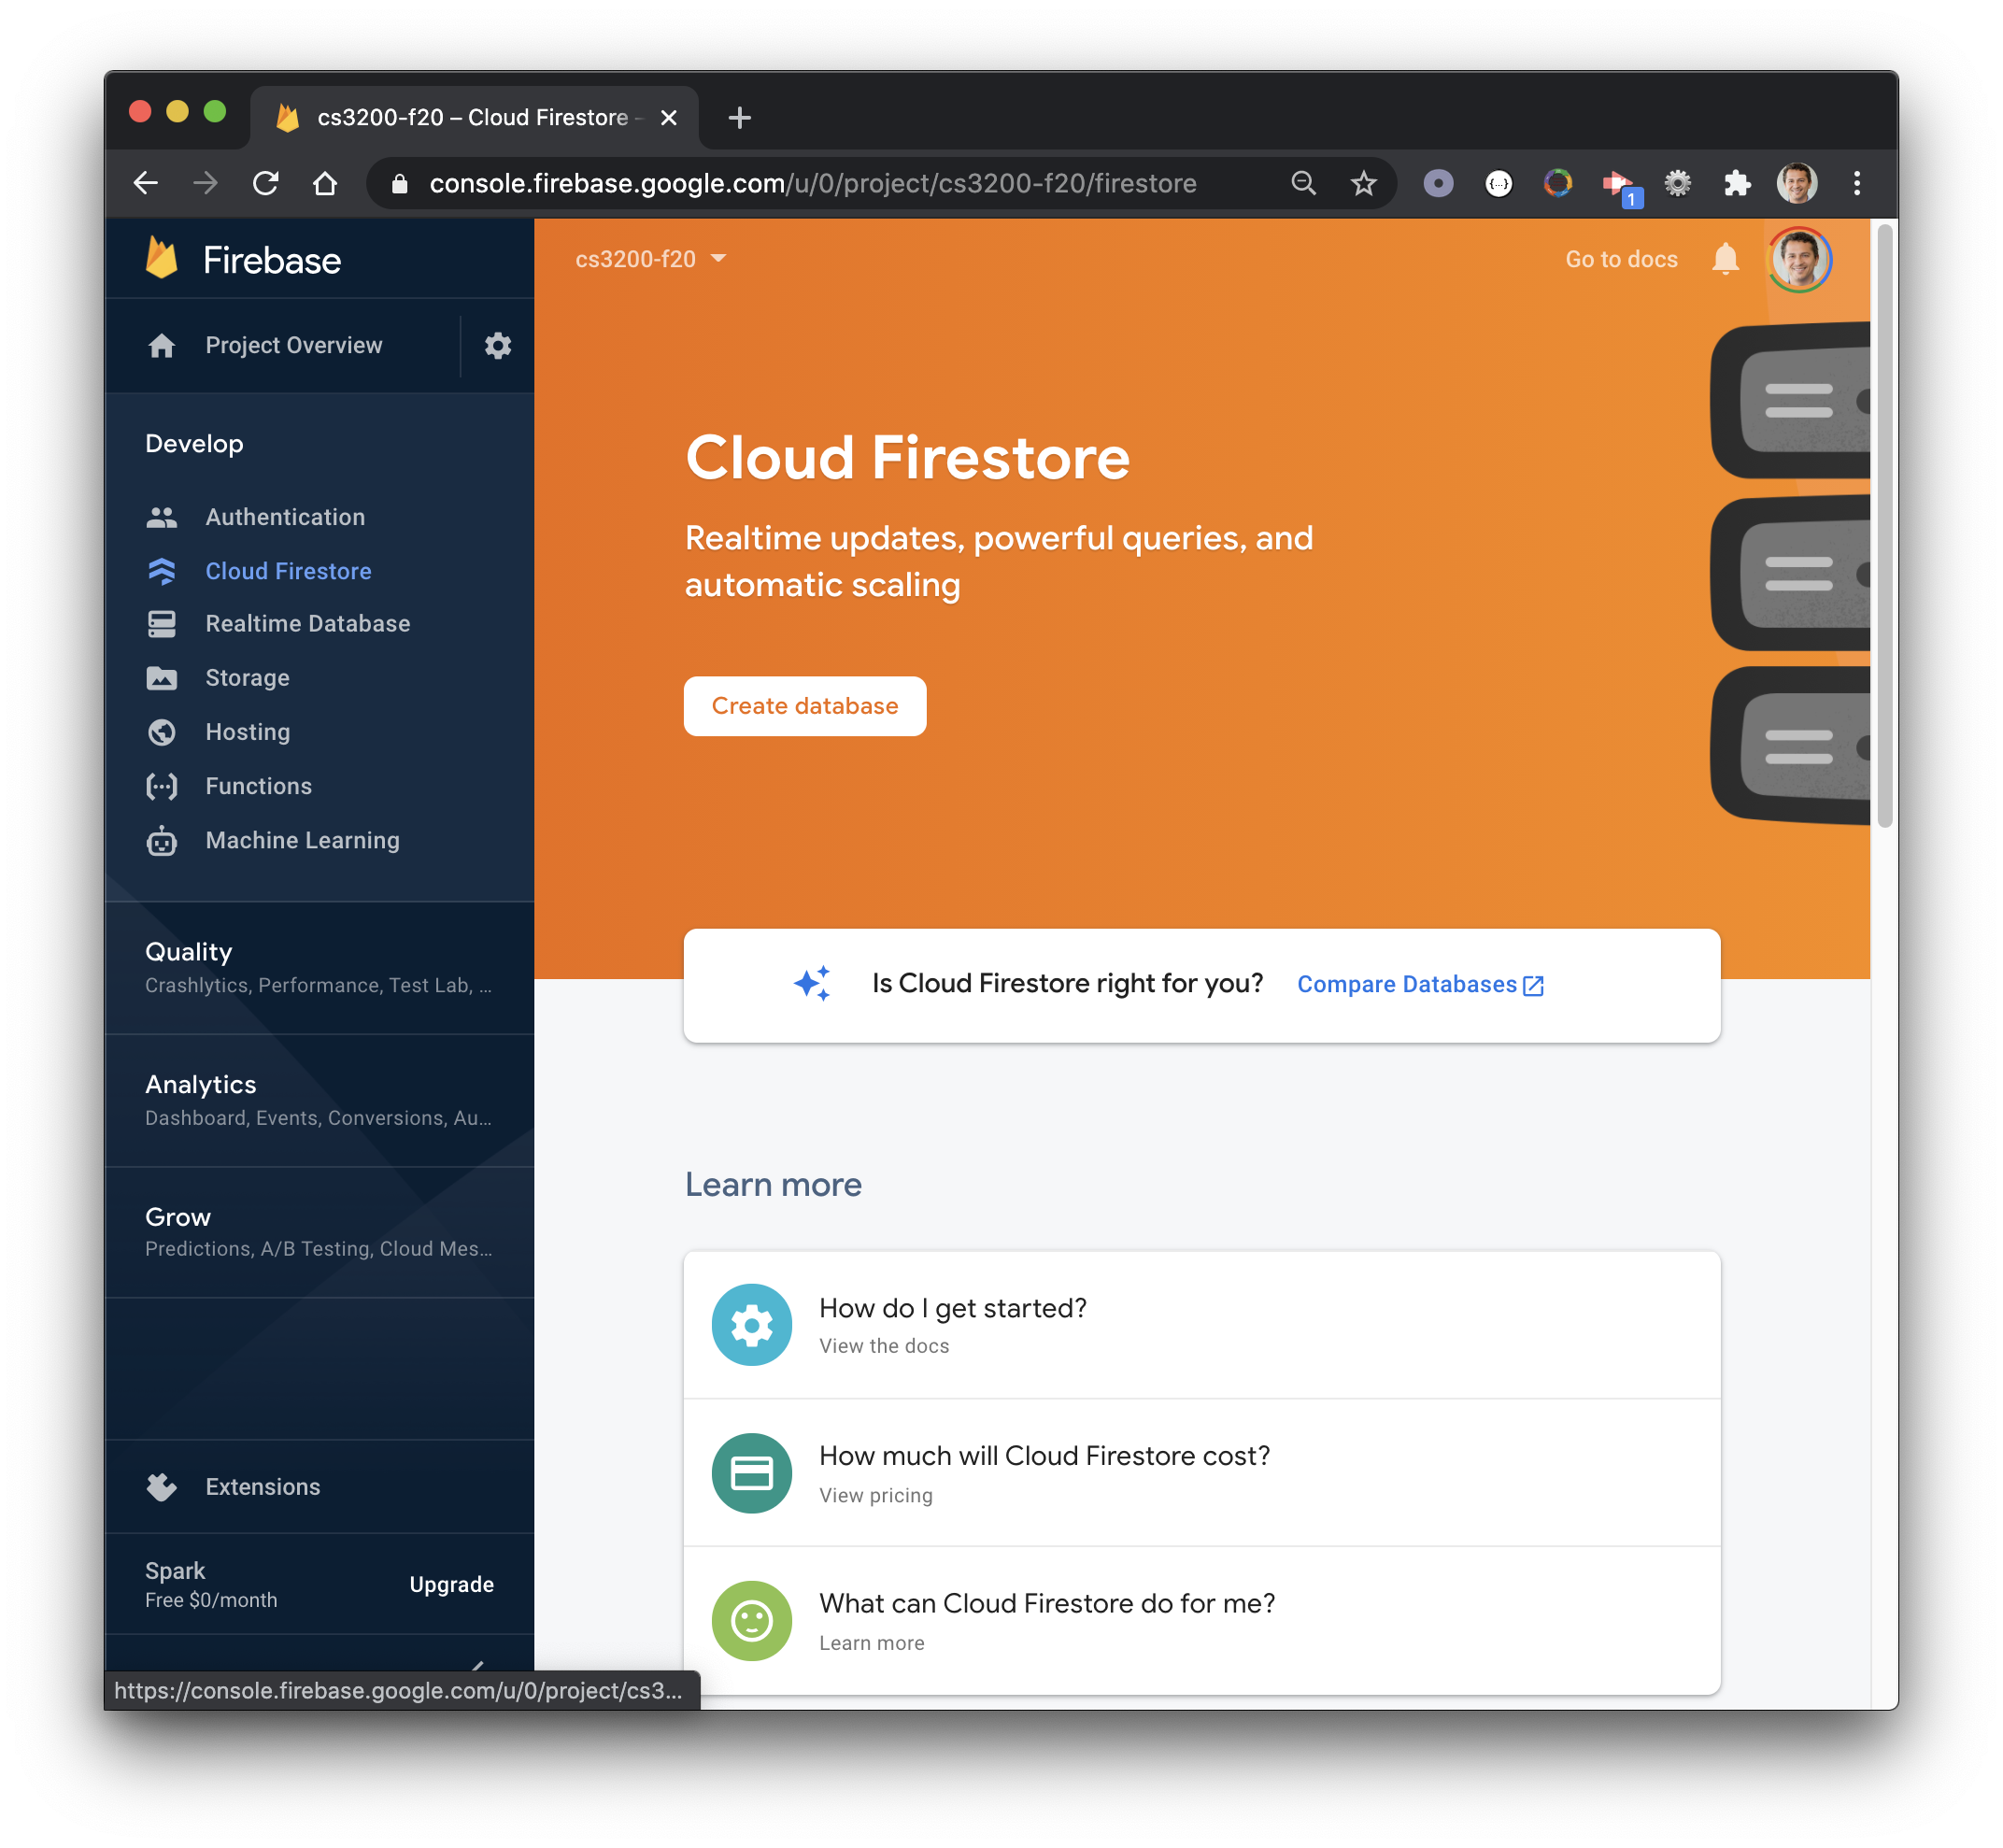
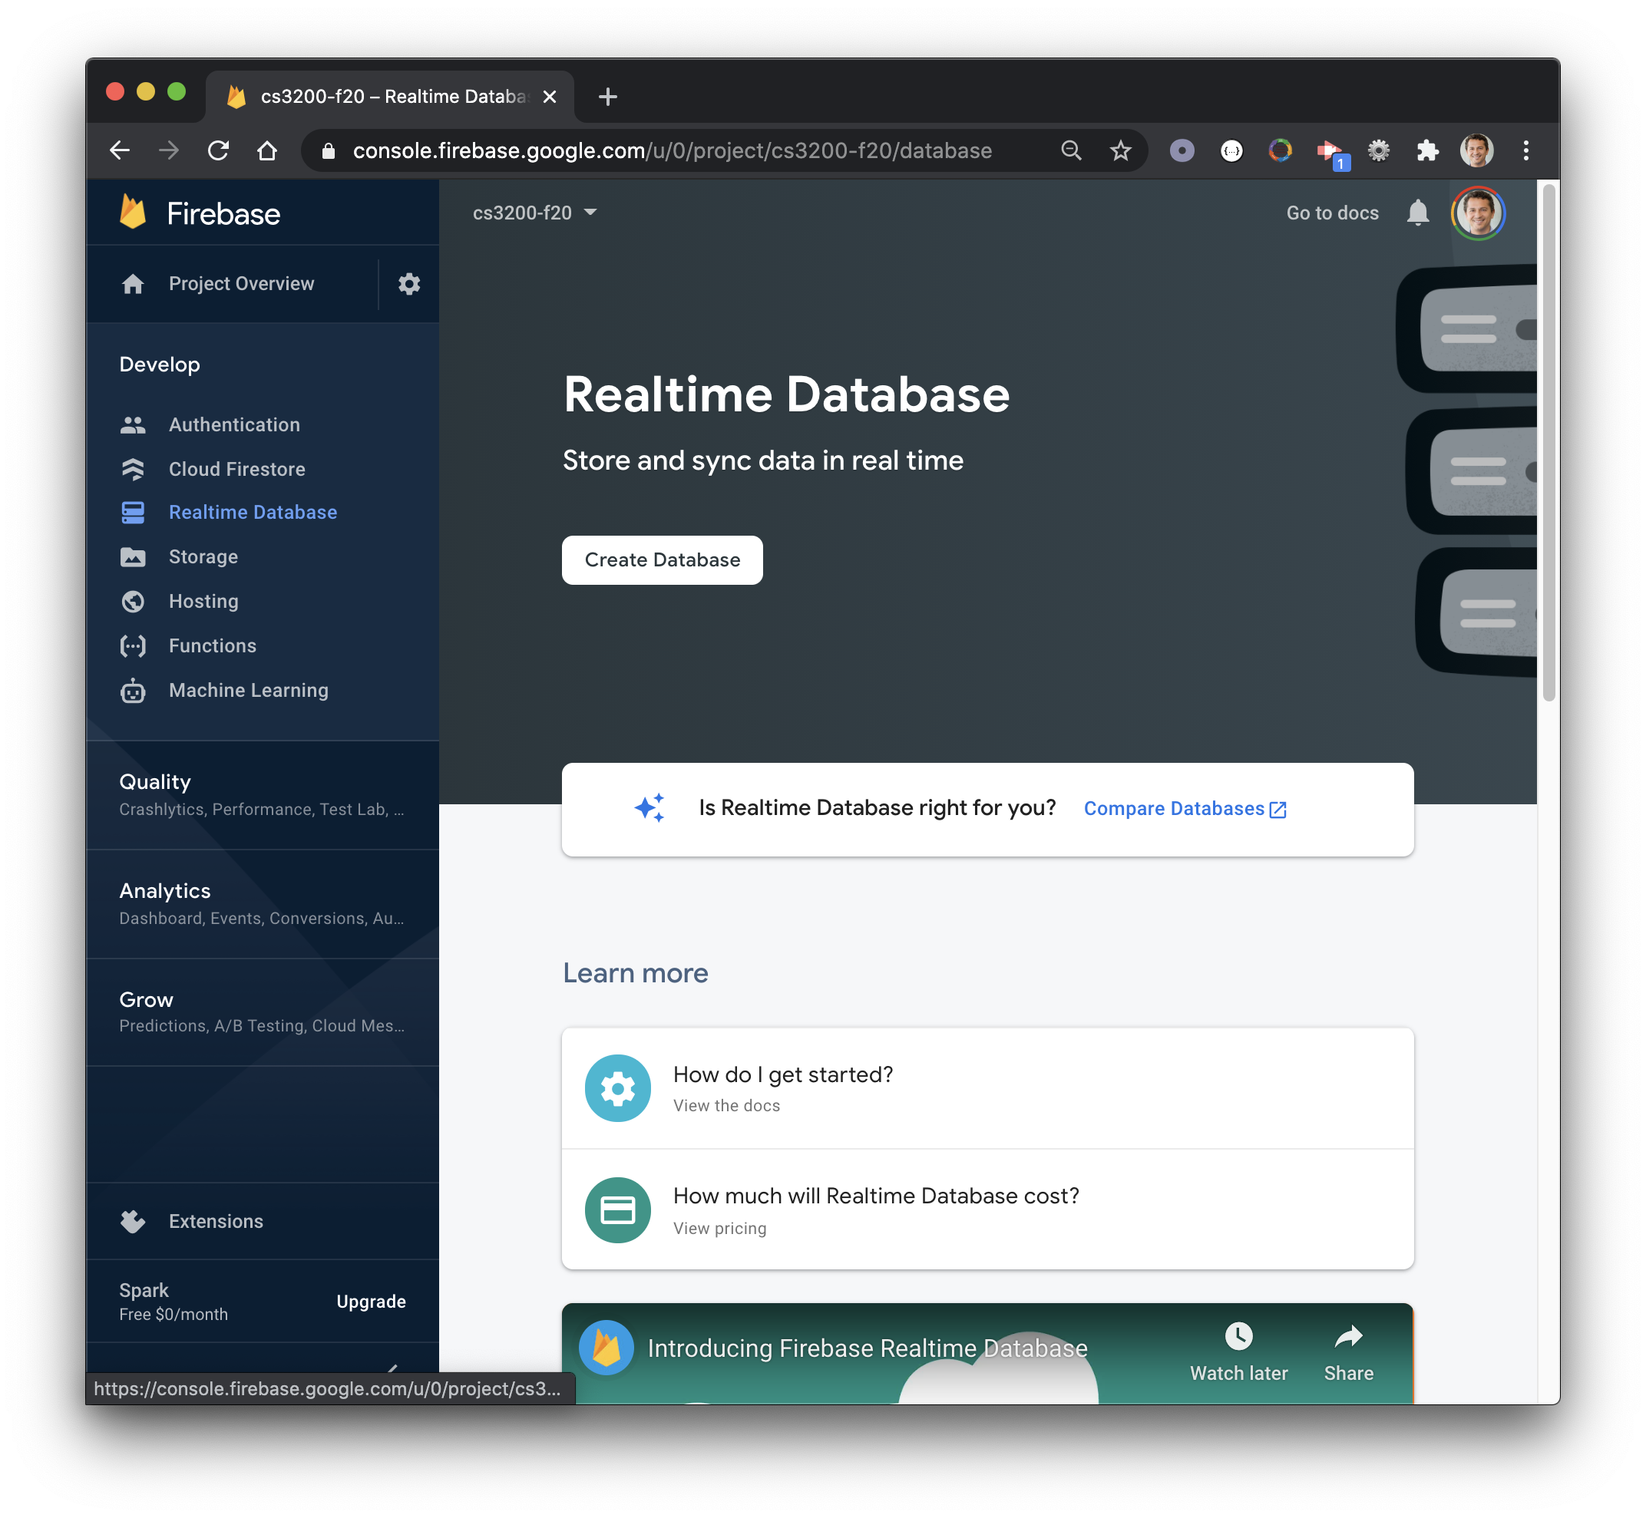
Cloud Firestore
Realtime Database
1
2

Slide 13
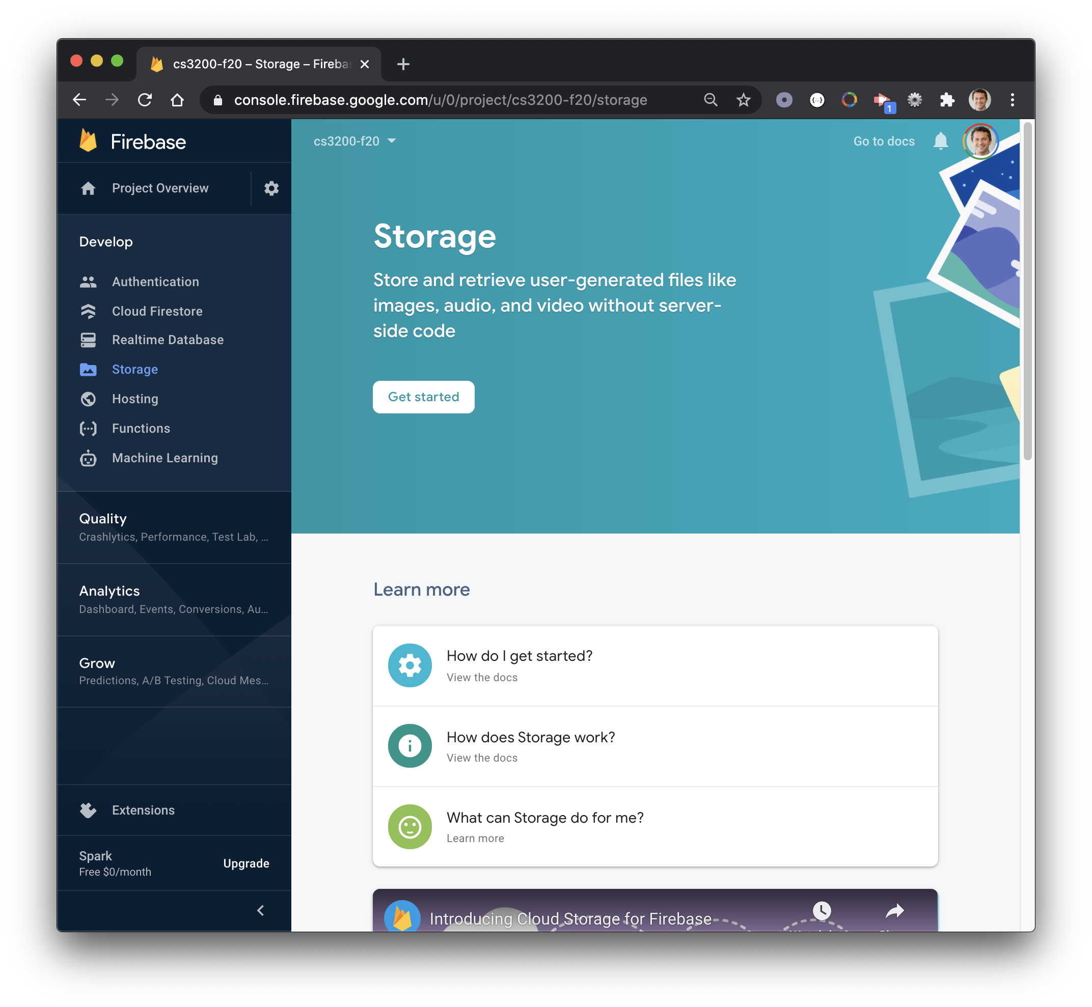
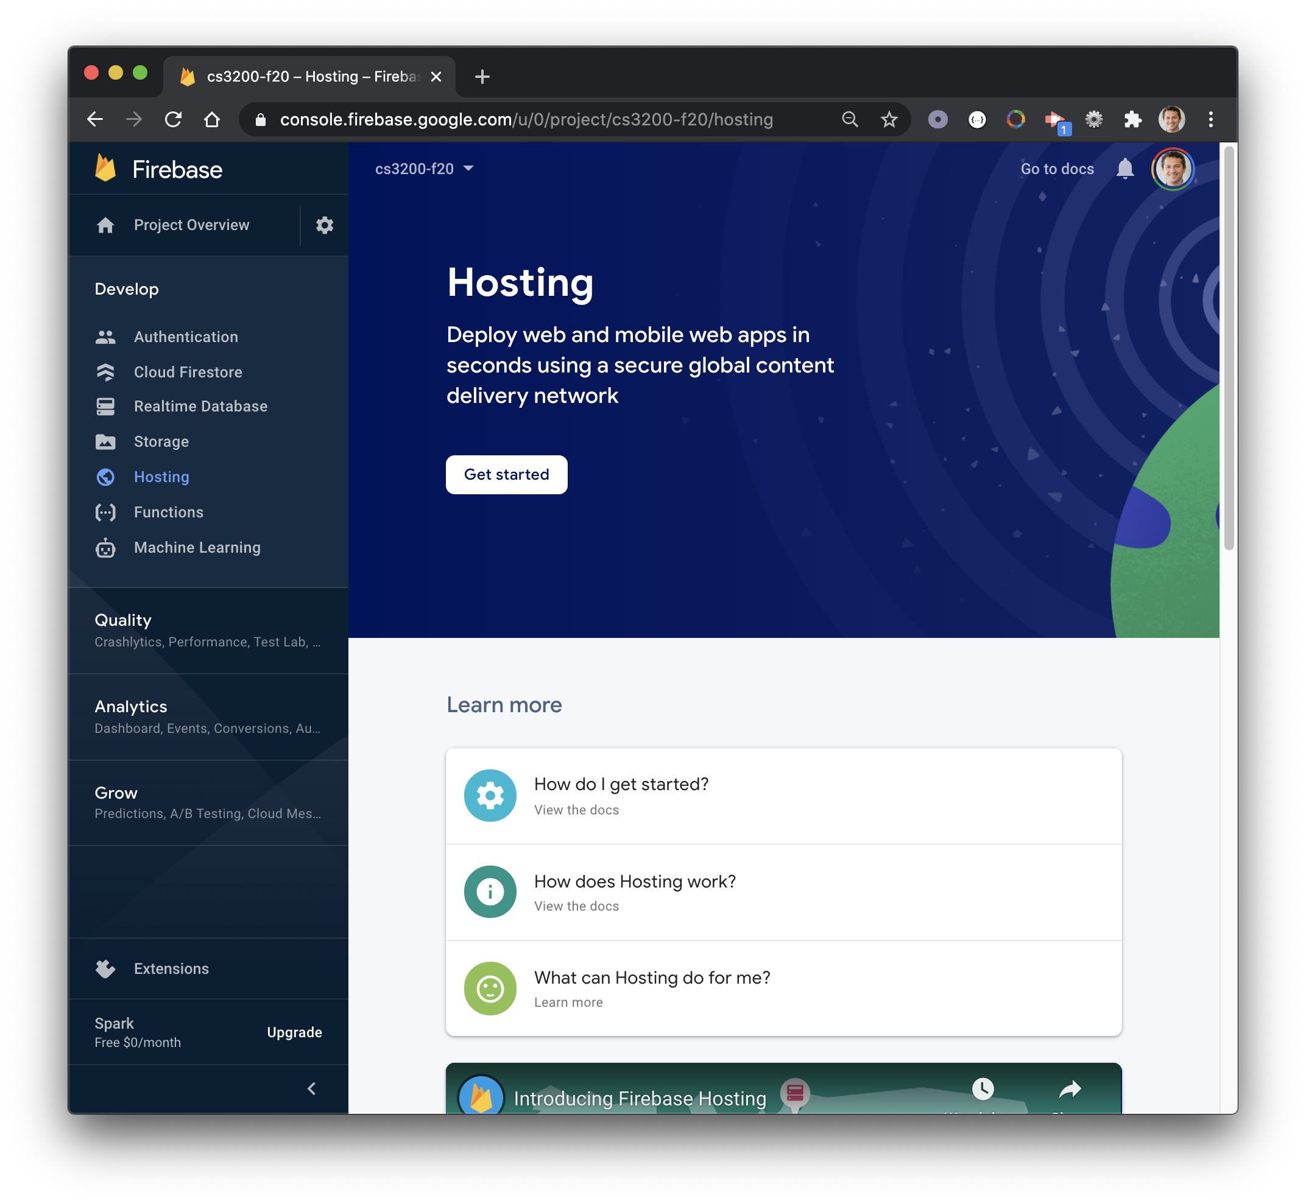
Storage
Hosting
1
2

Slide 14
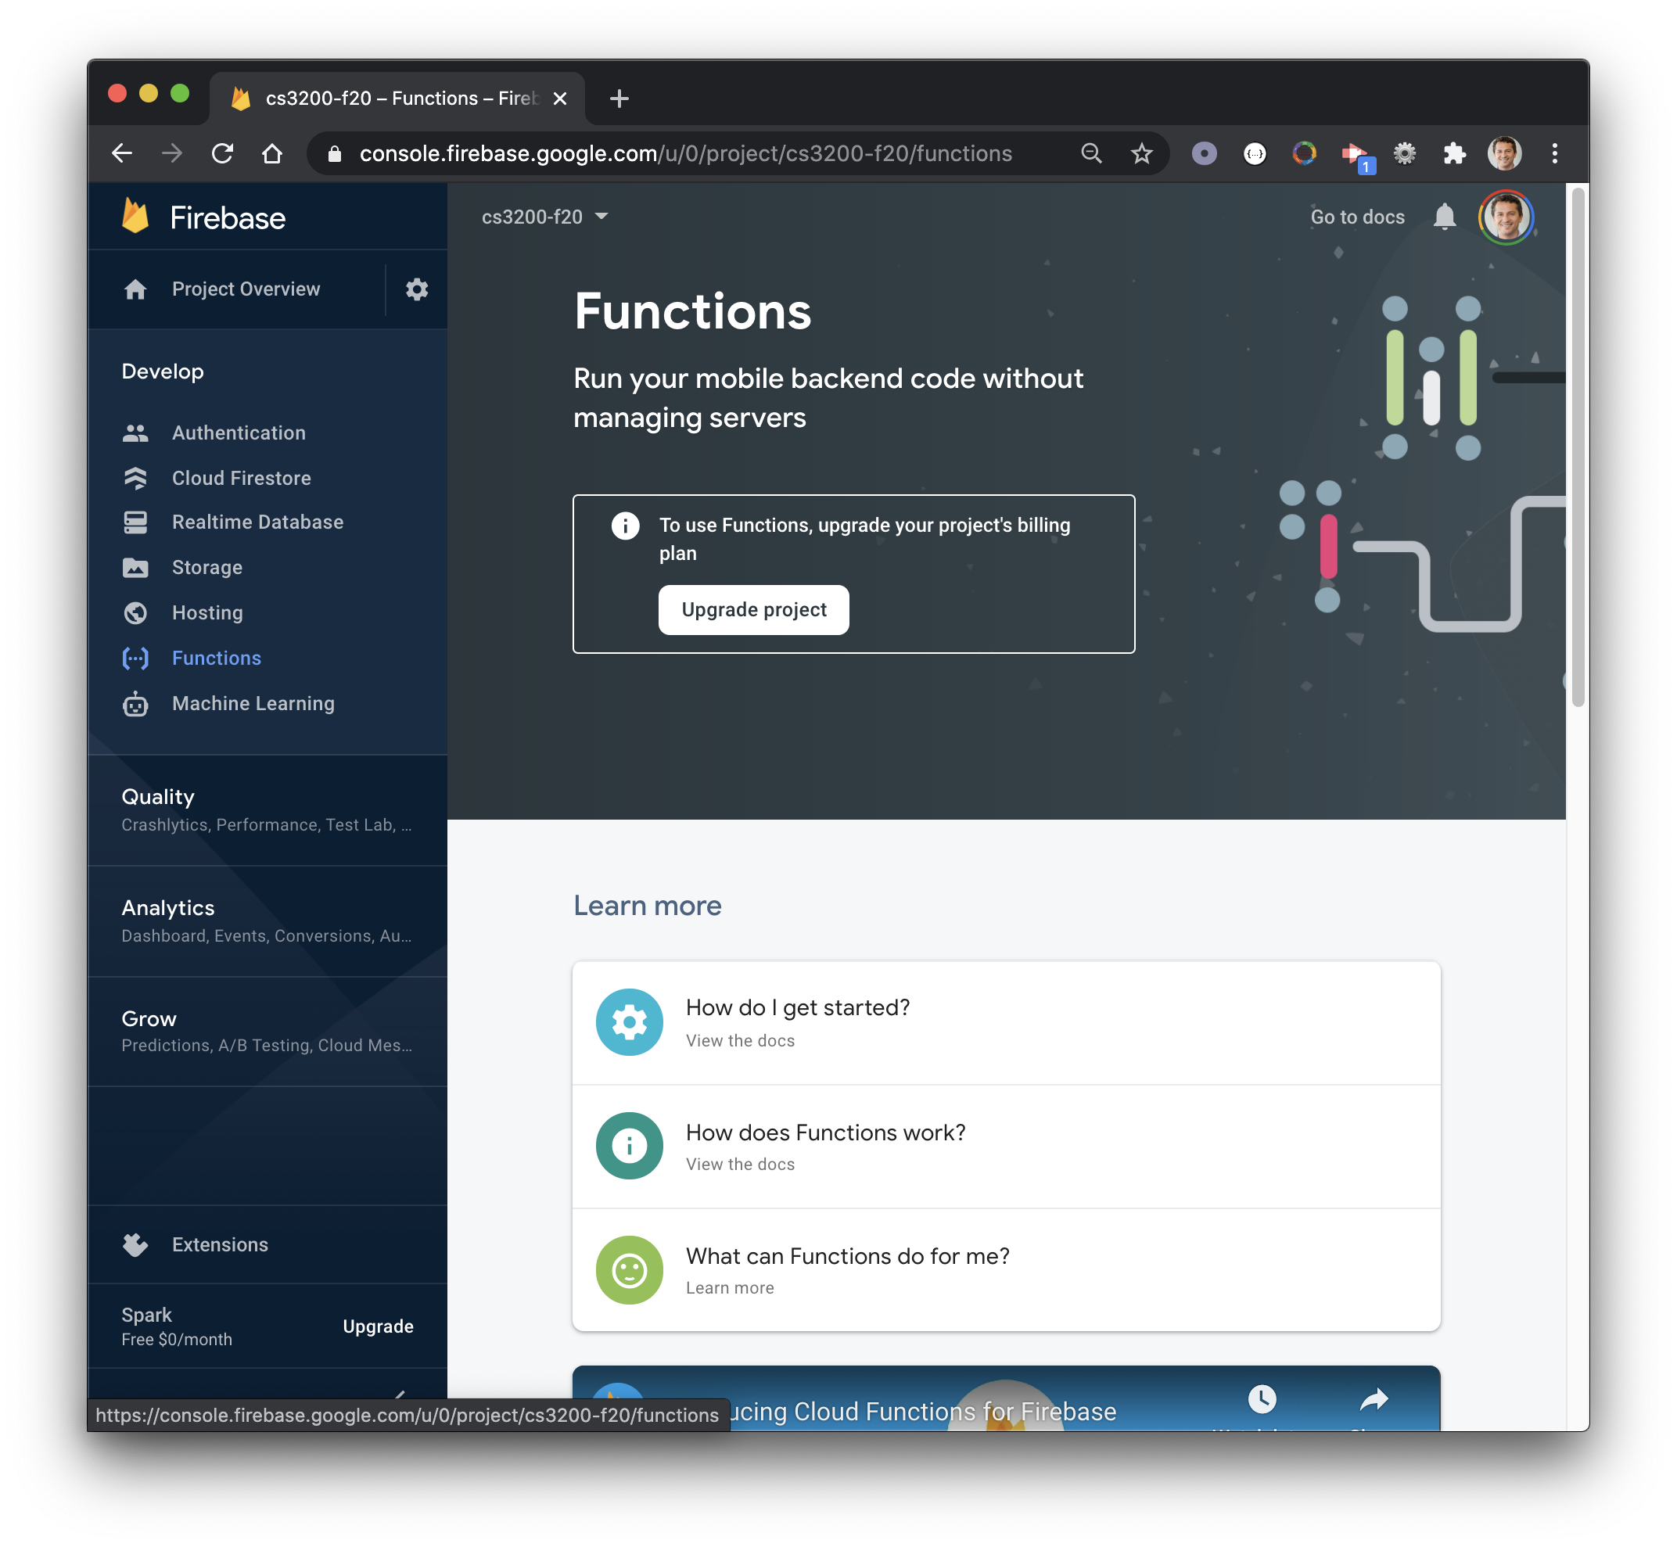
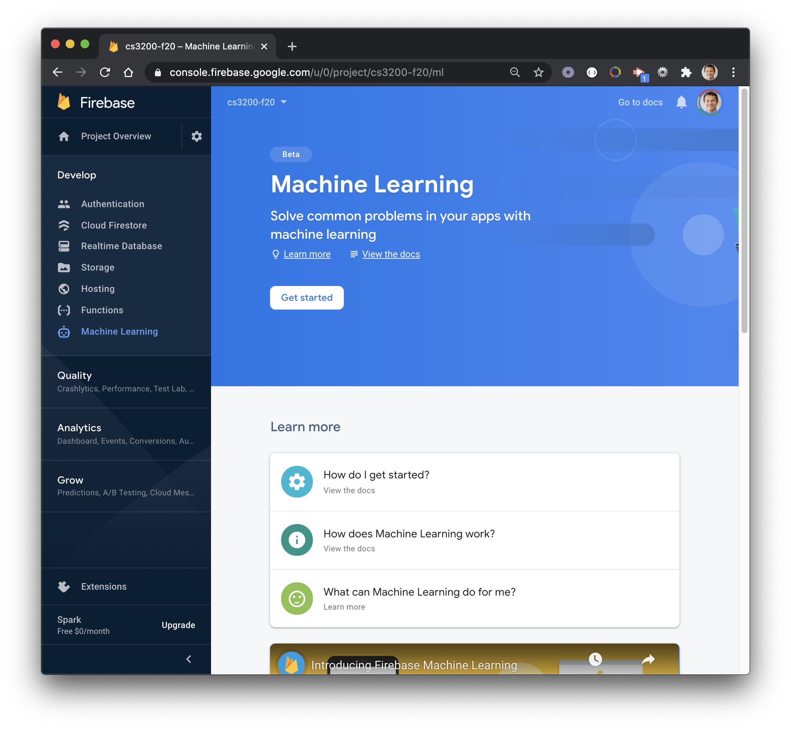
Functions
Machine Learning
1
2

Slide 15
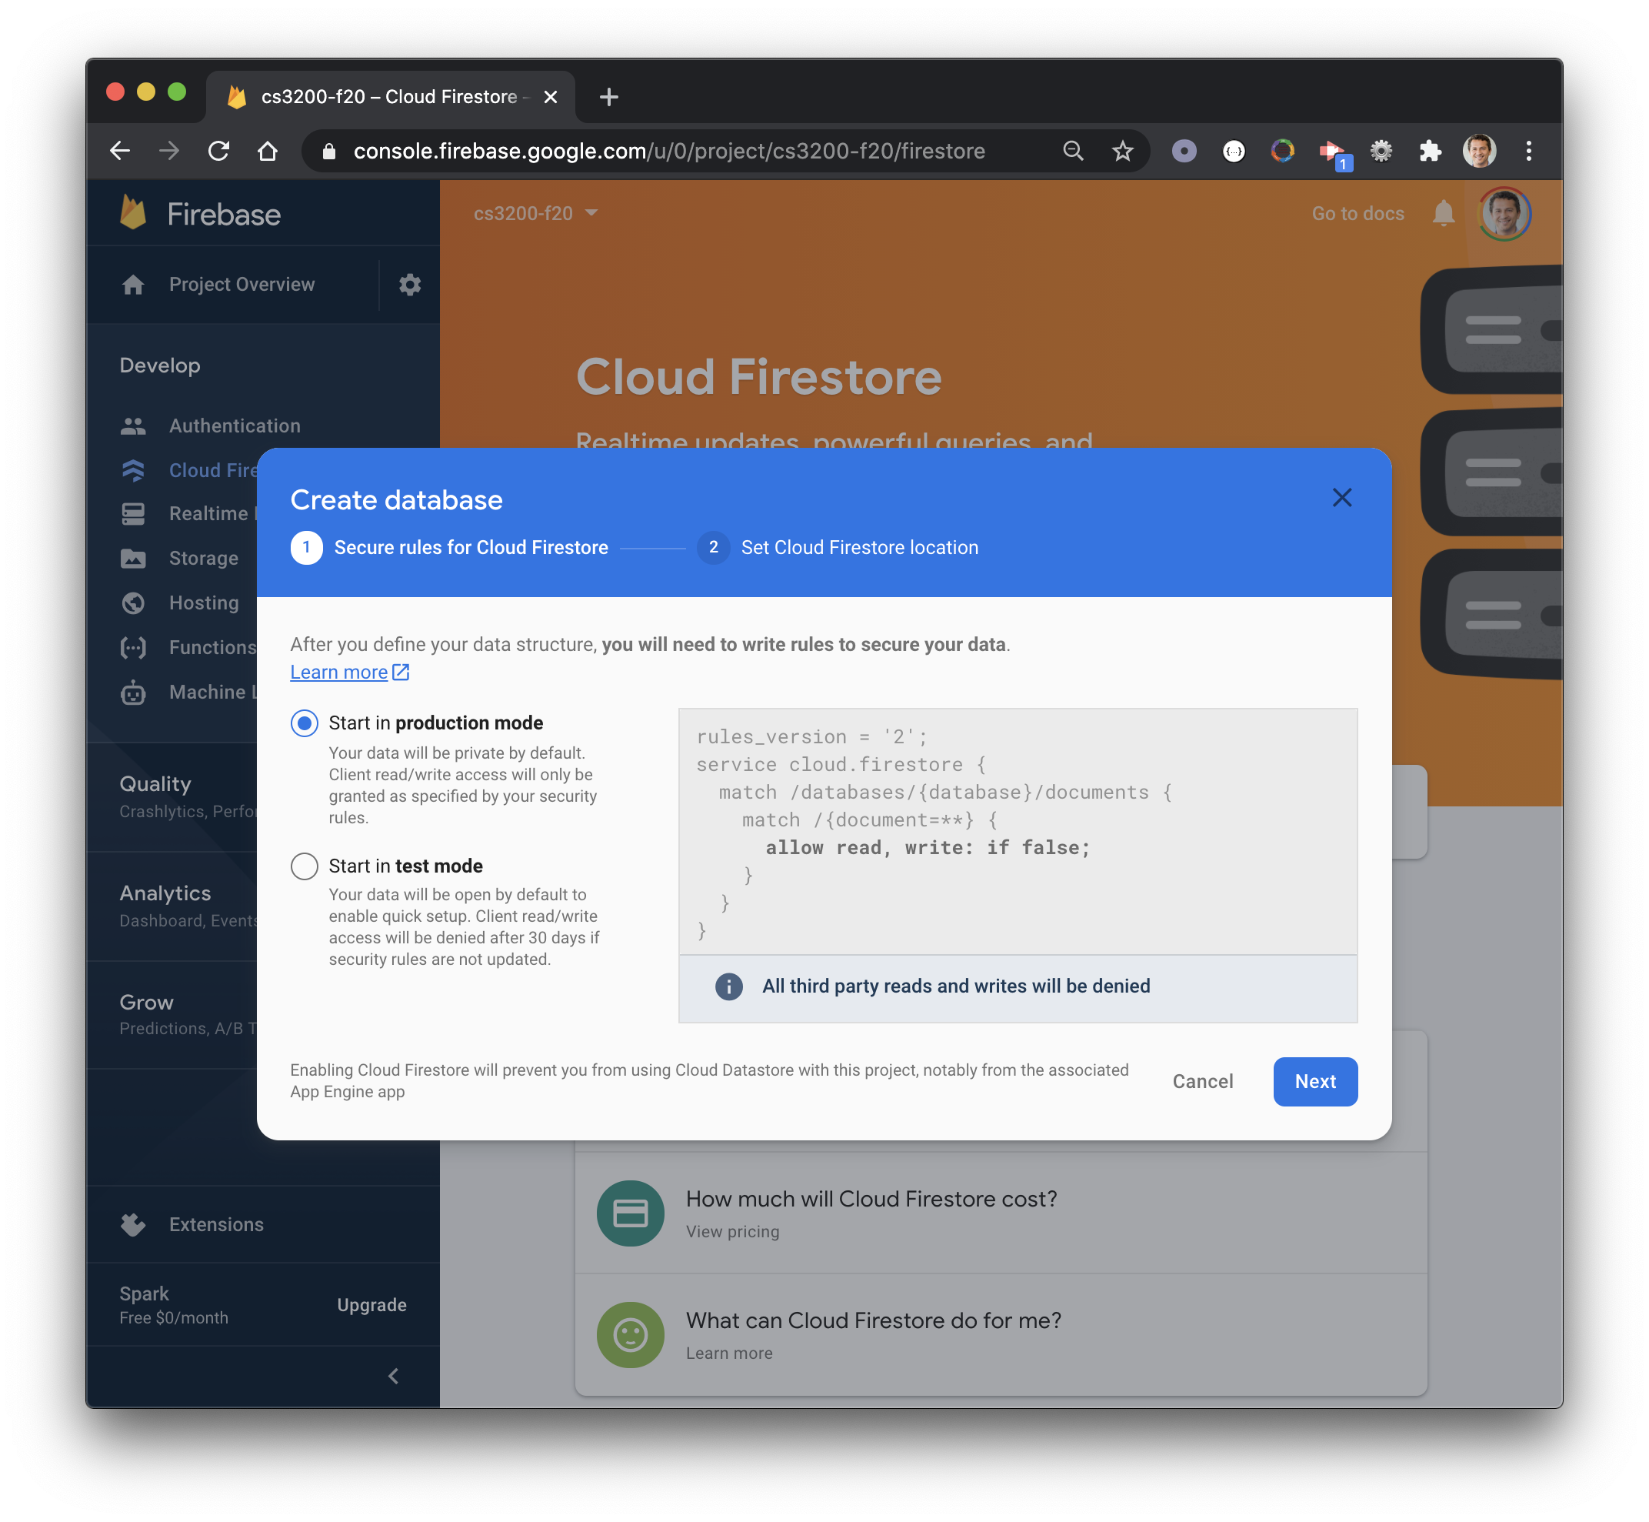
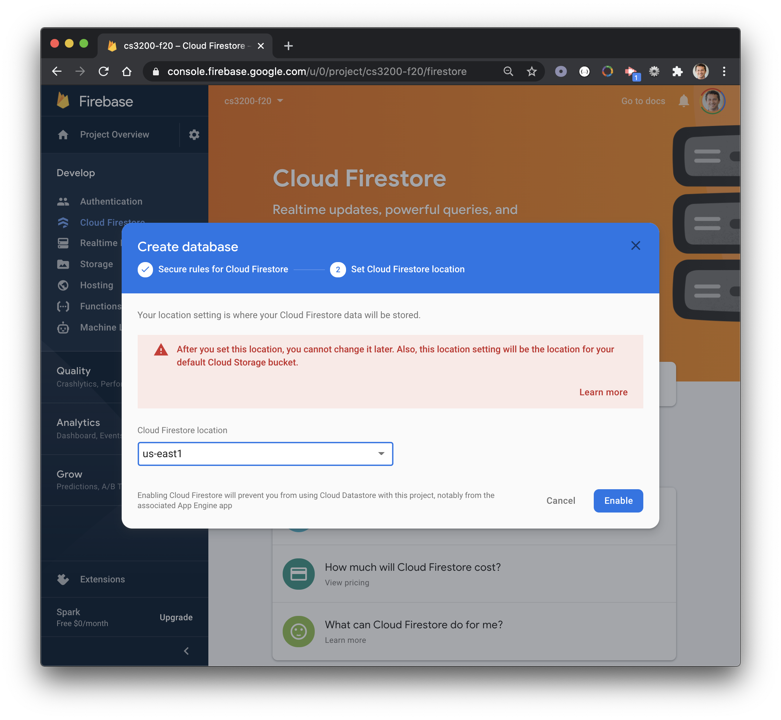
1
3
2
4

Slide 16
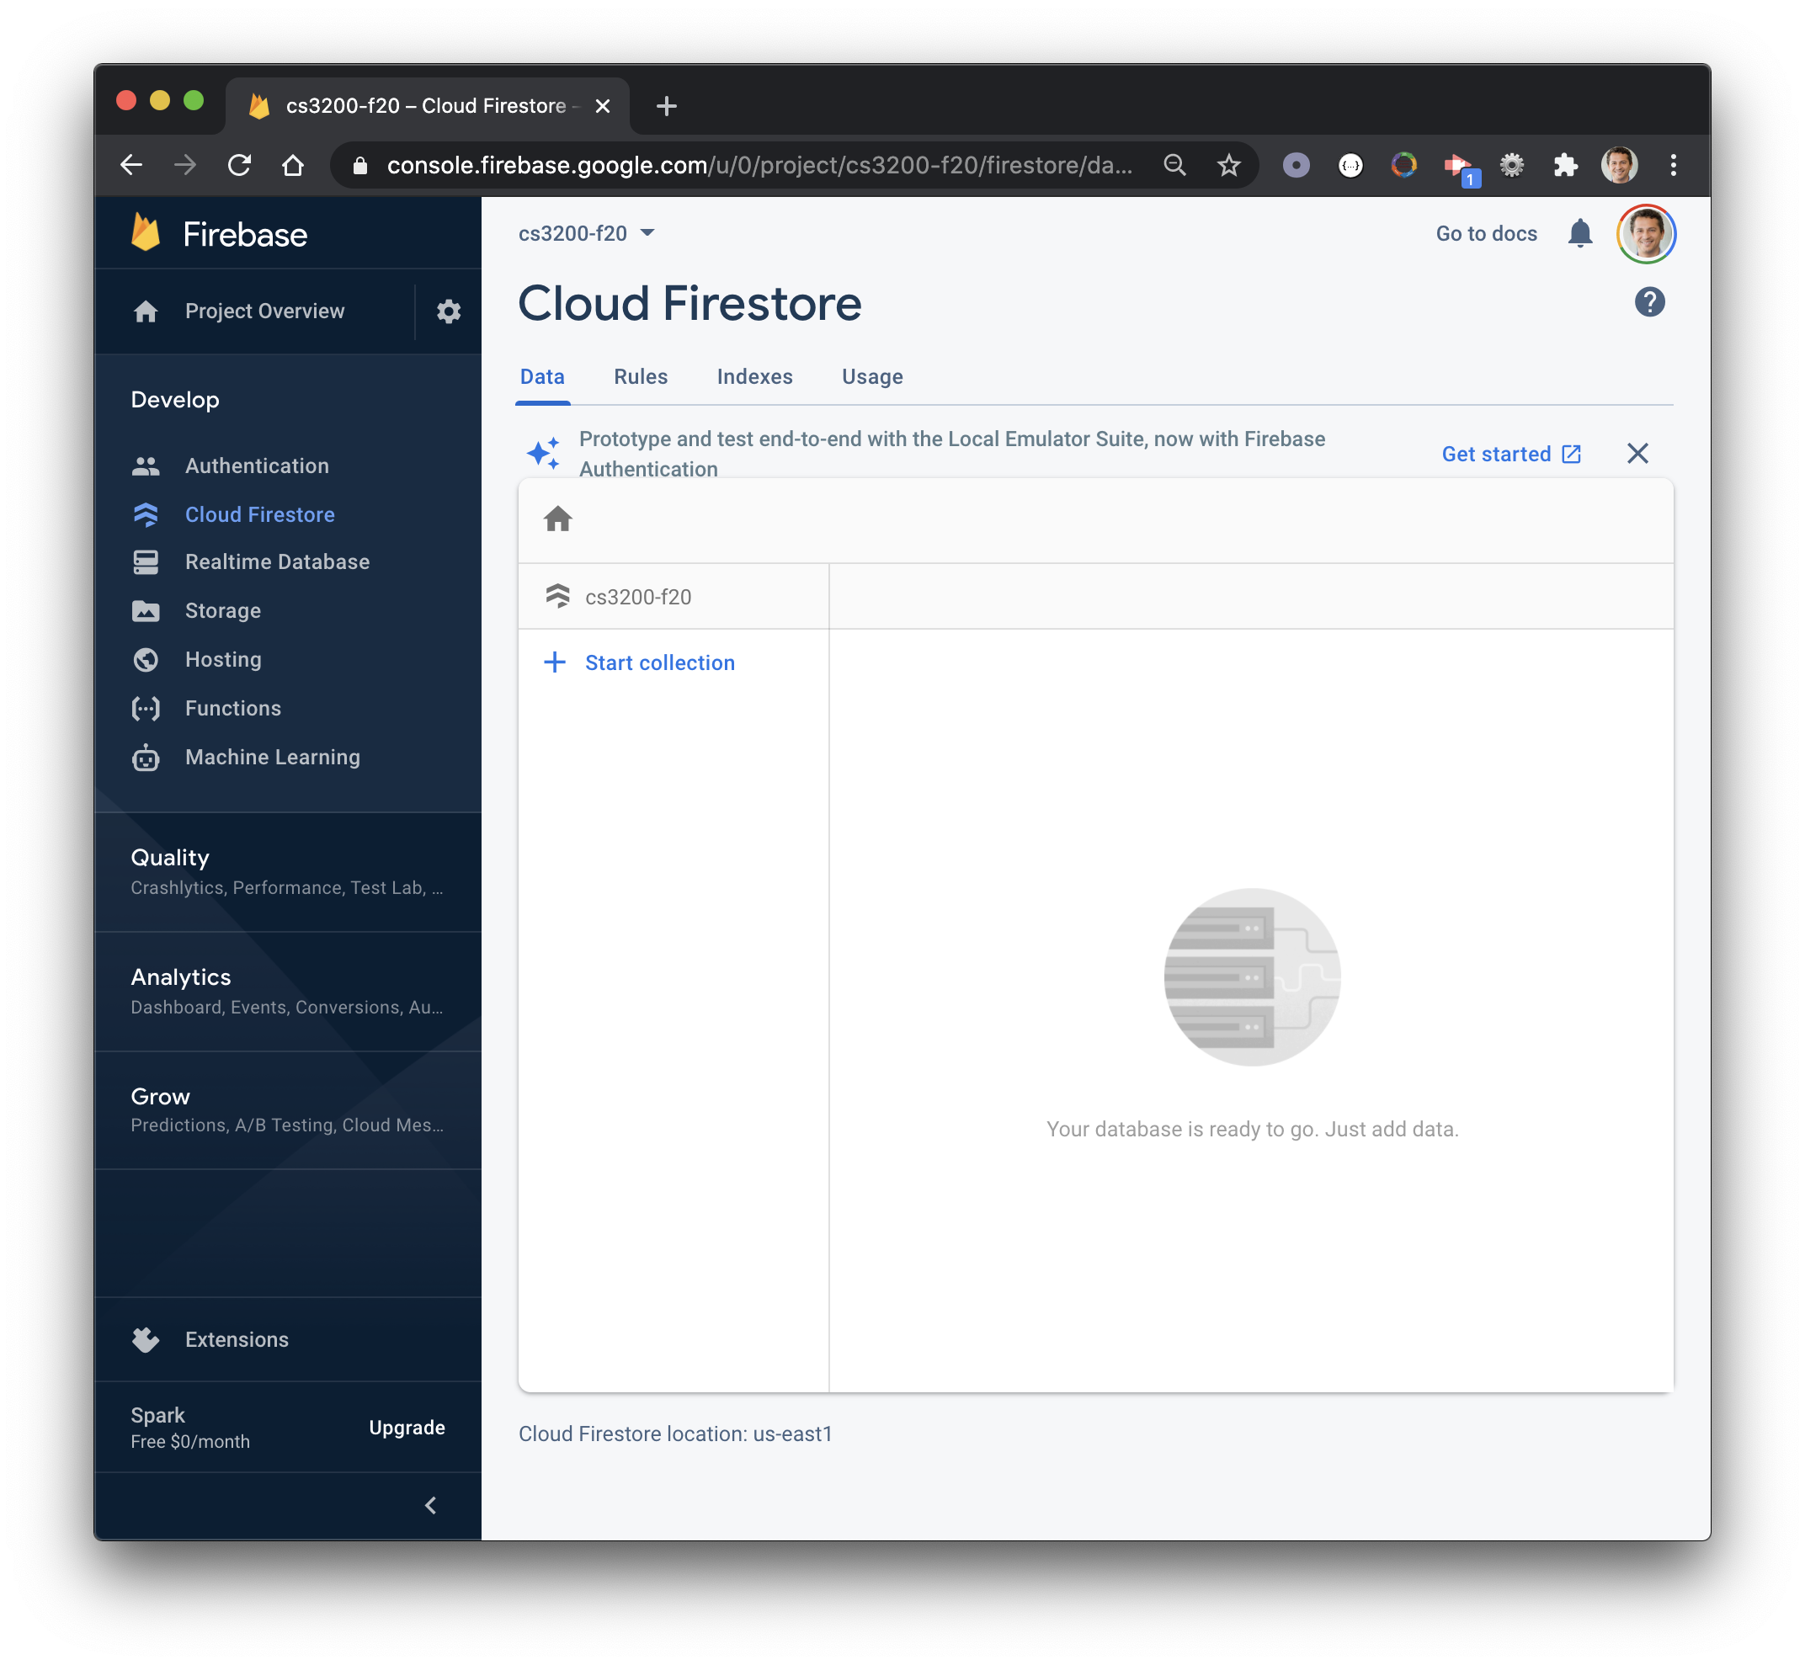
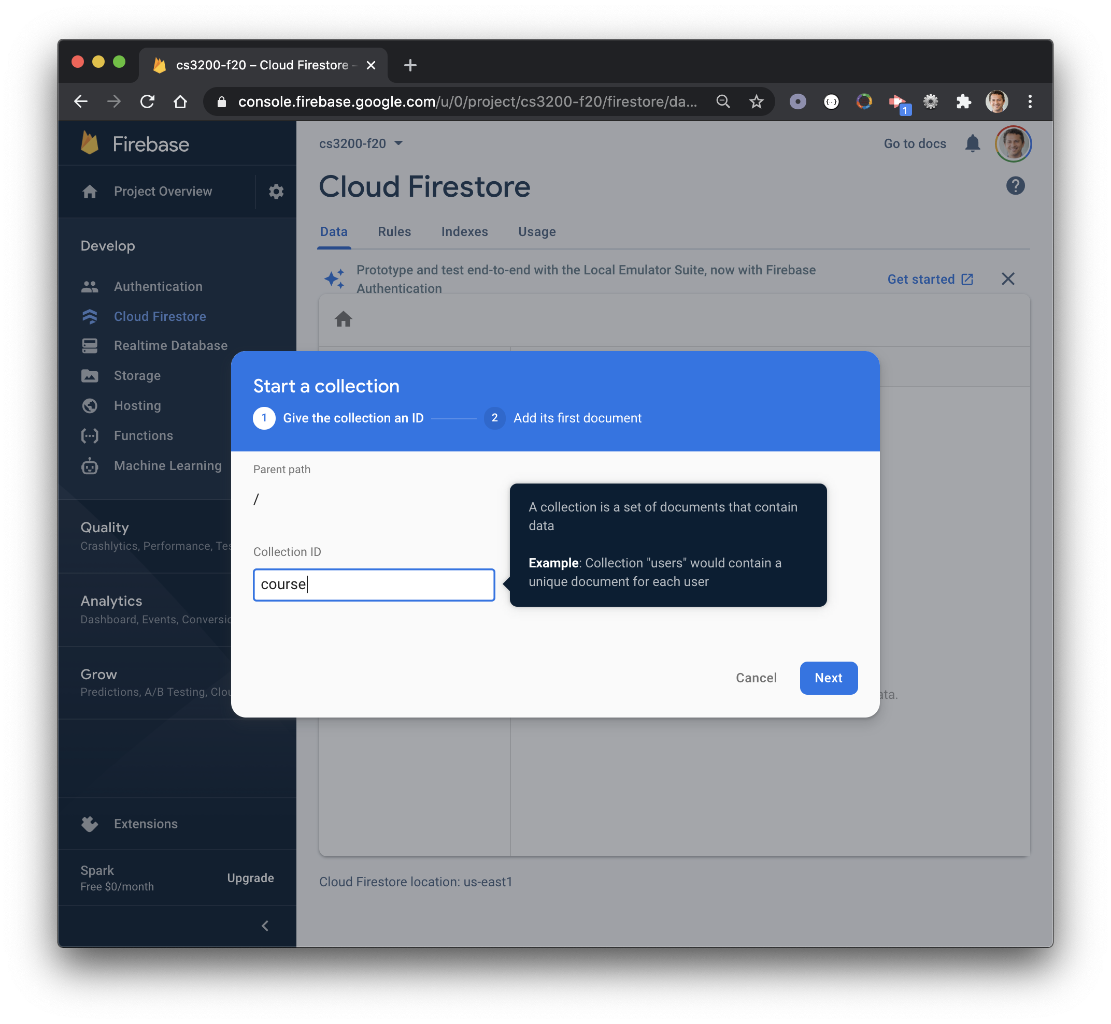
Create
collection
1
2
Name
collection
3

Slide 17
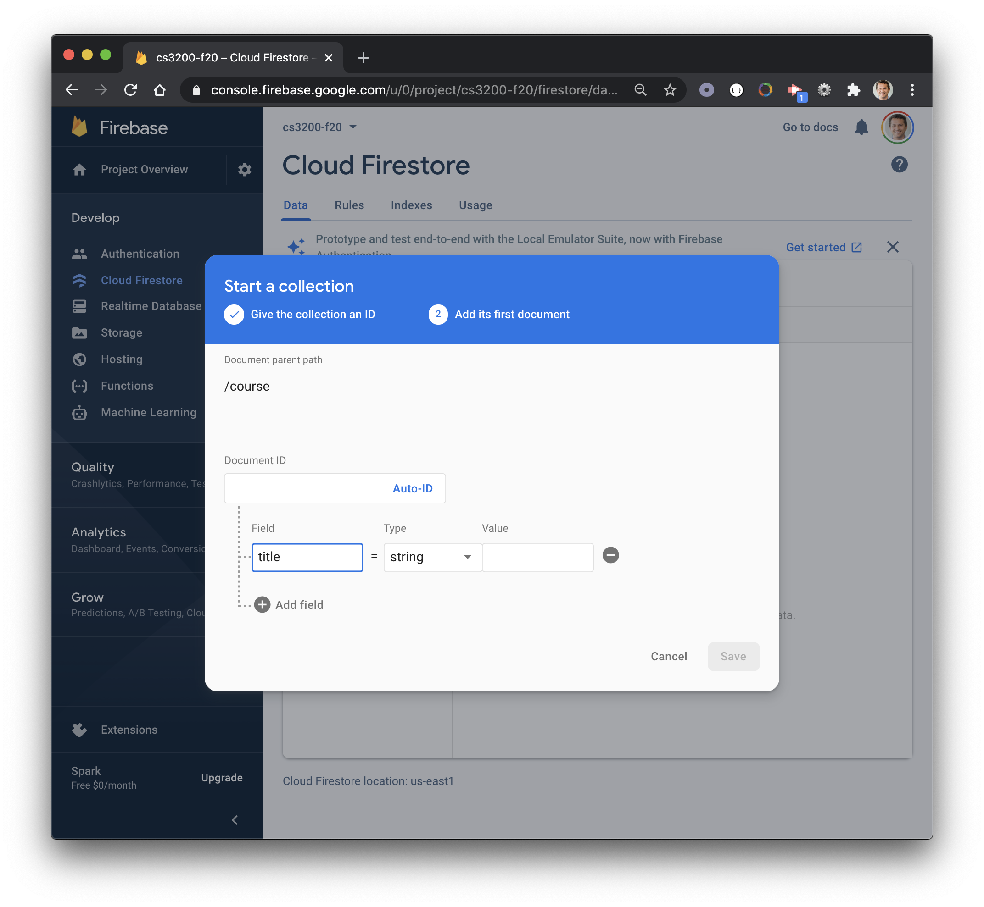
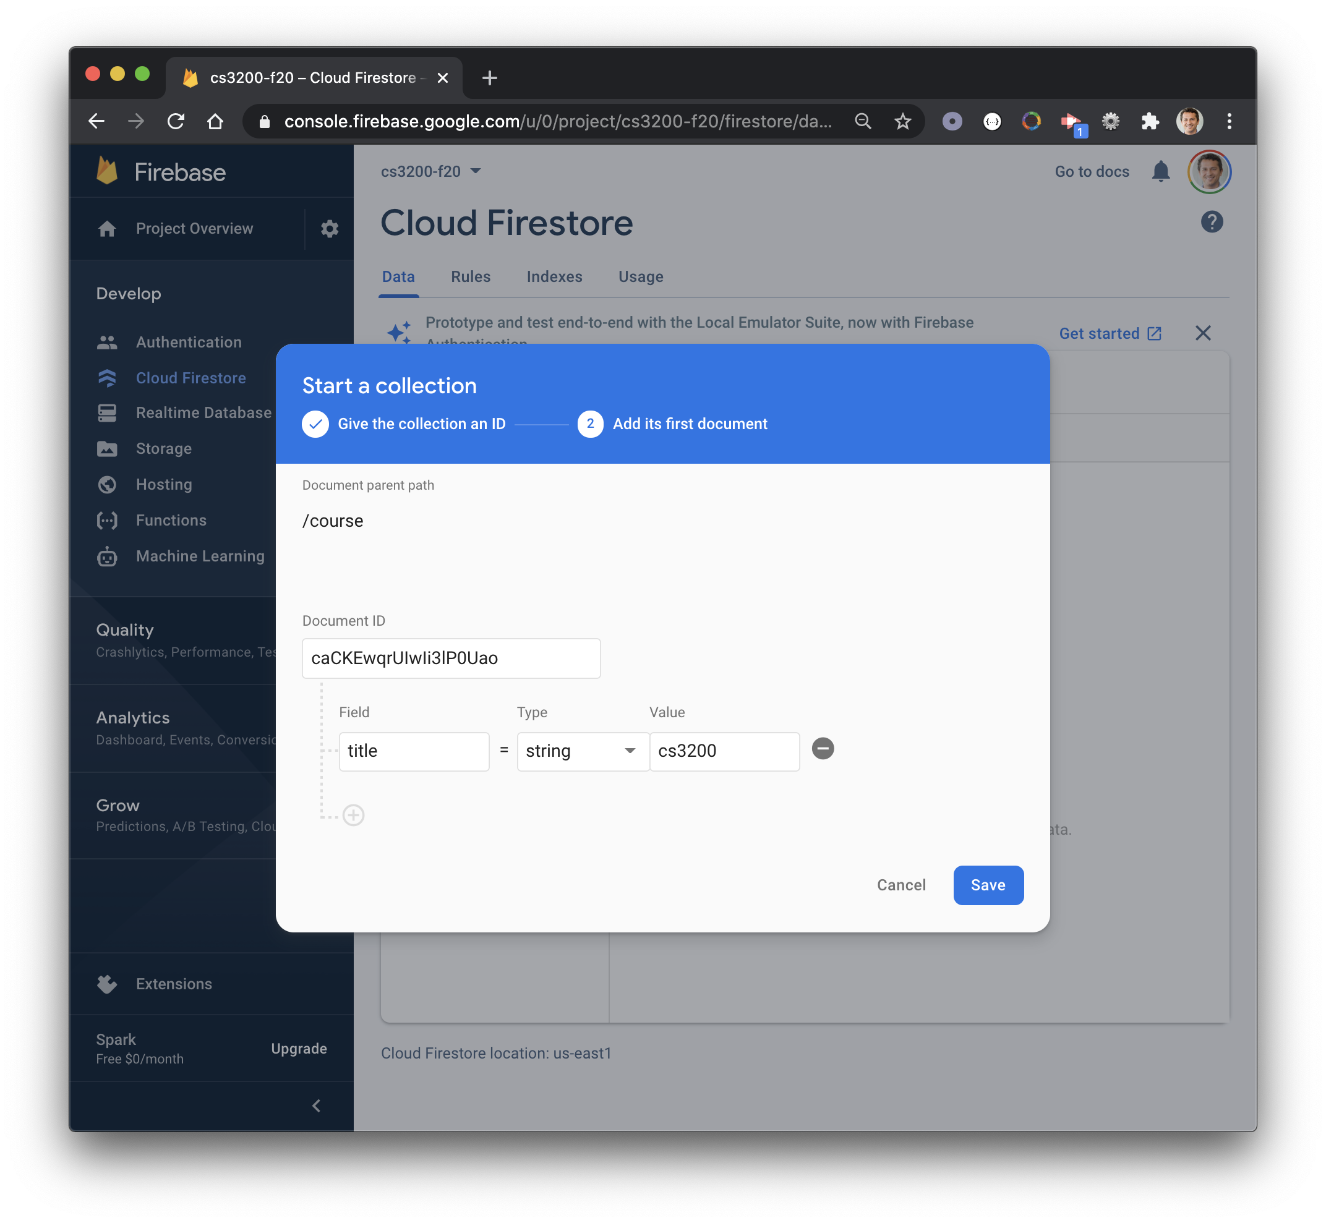
Set value
1
Set ID
4
2
Name field
Type
3
5

Slide 18
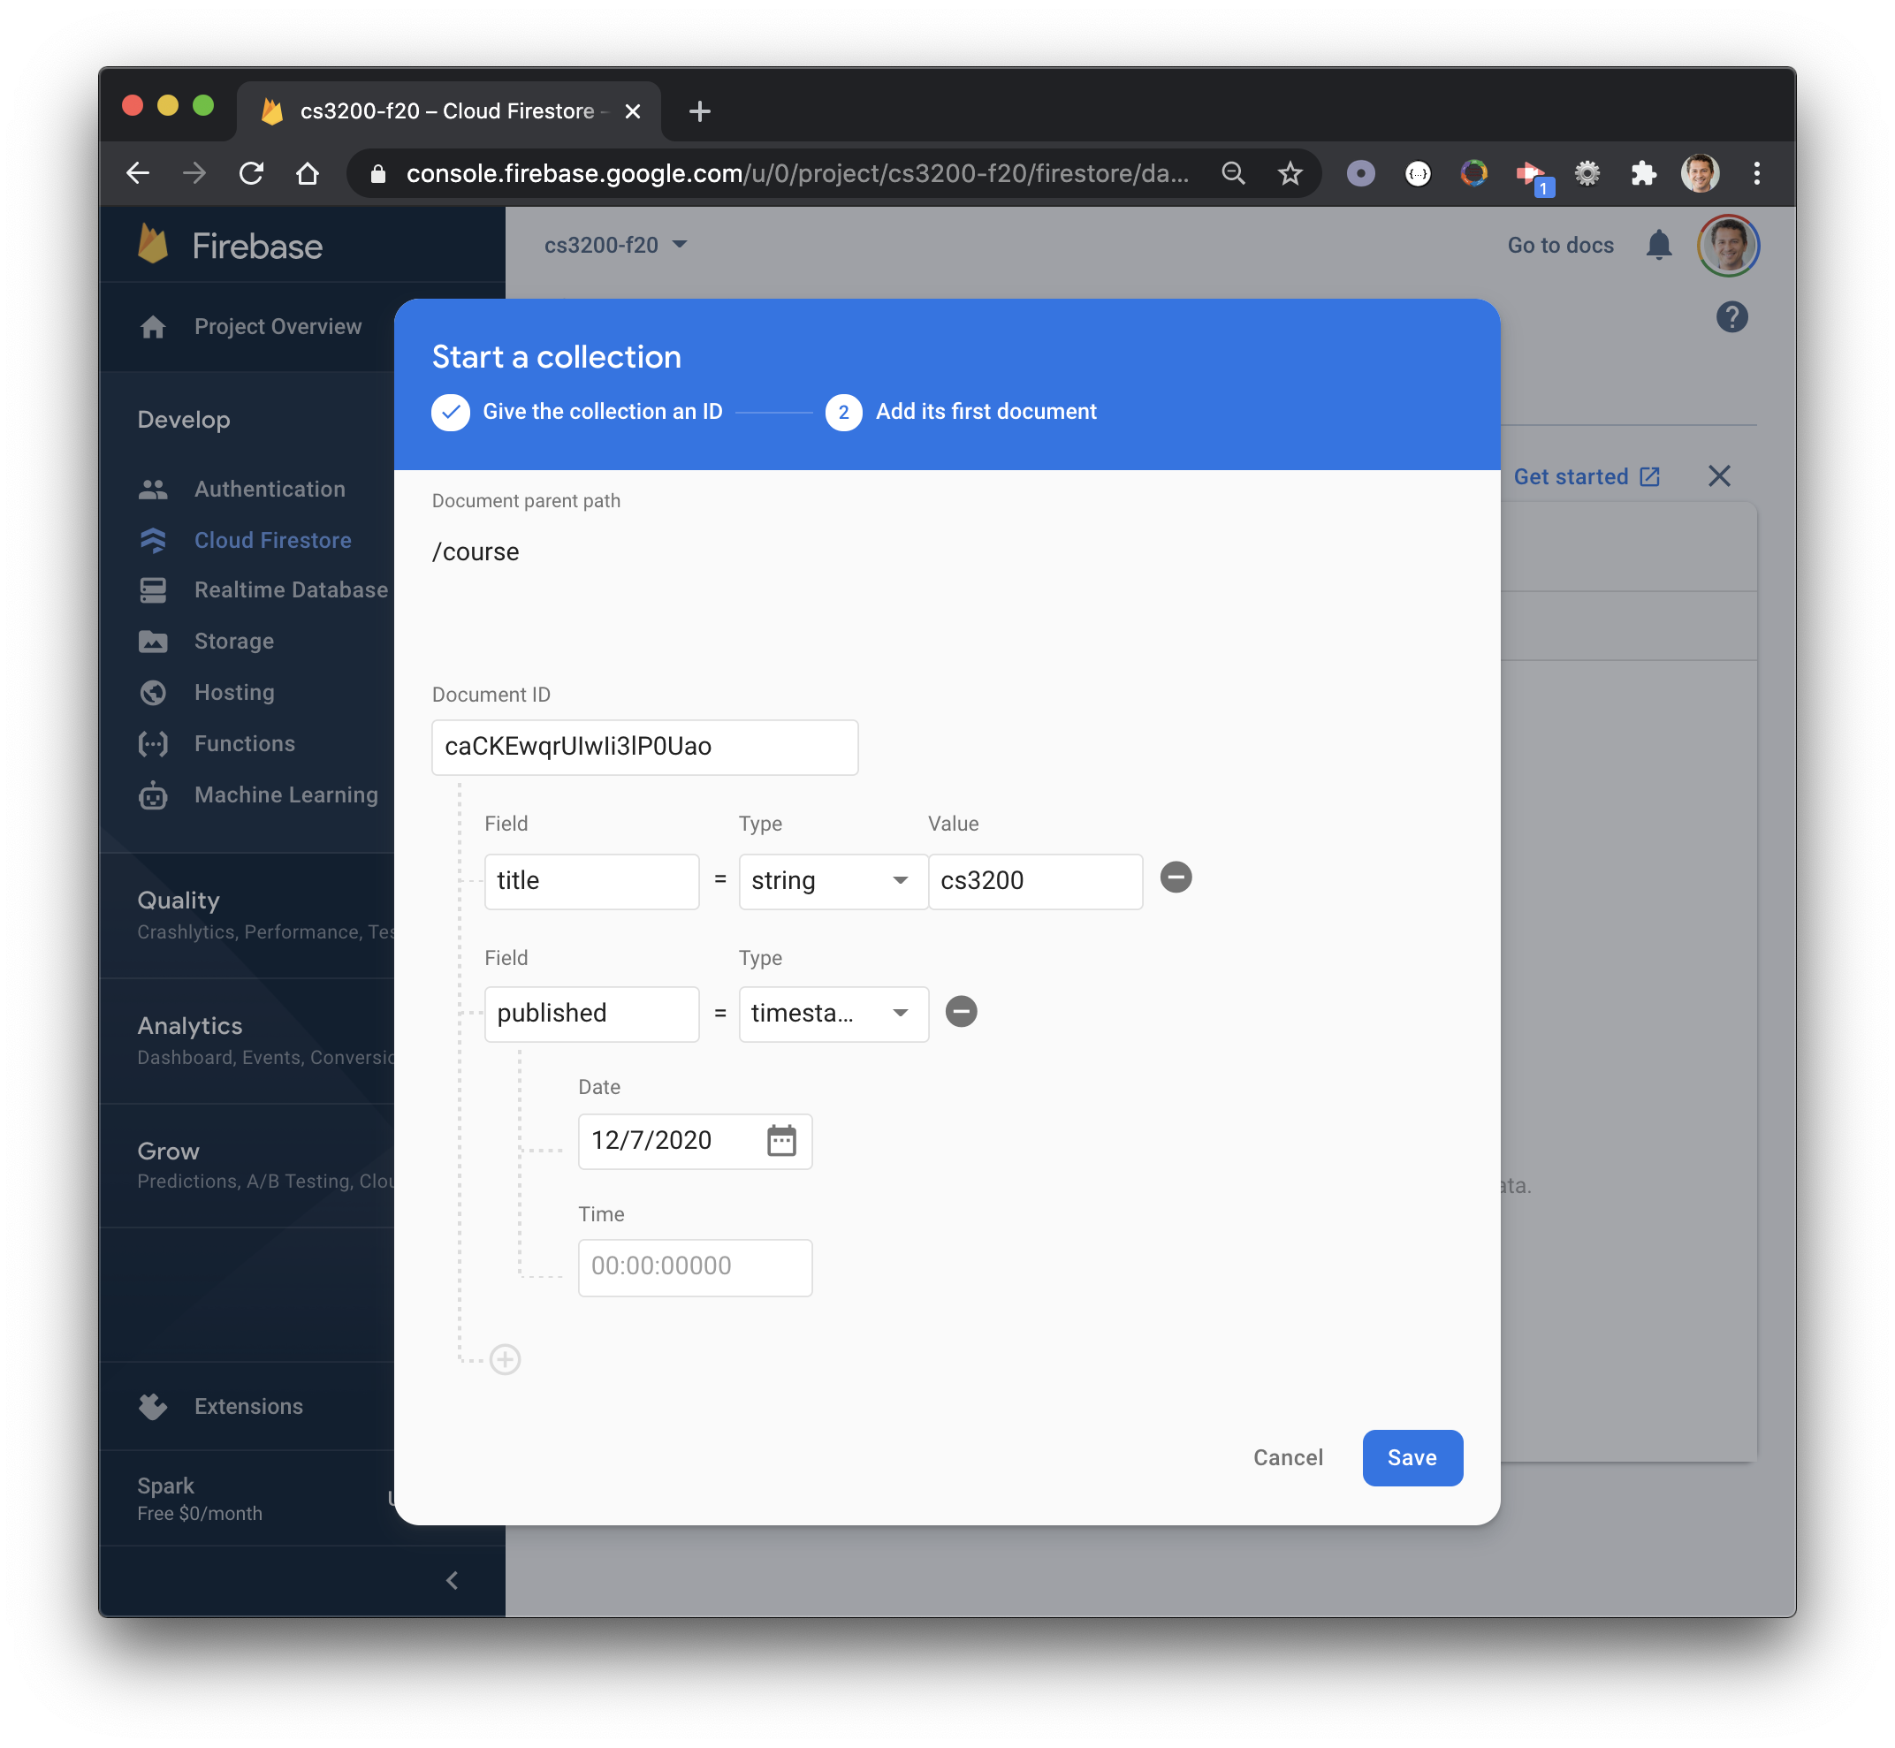
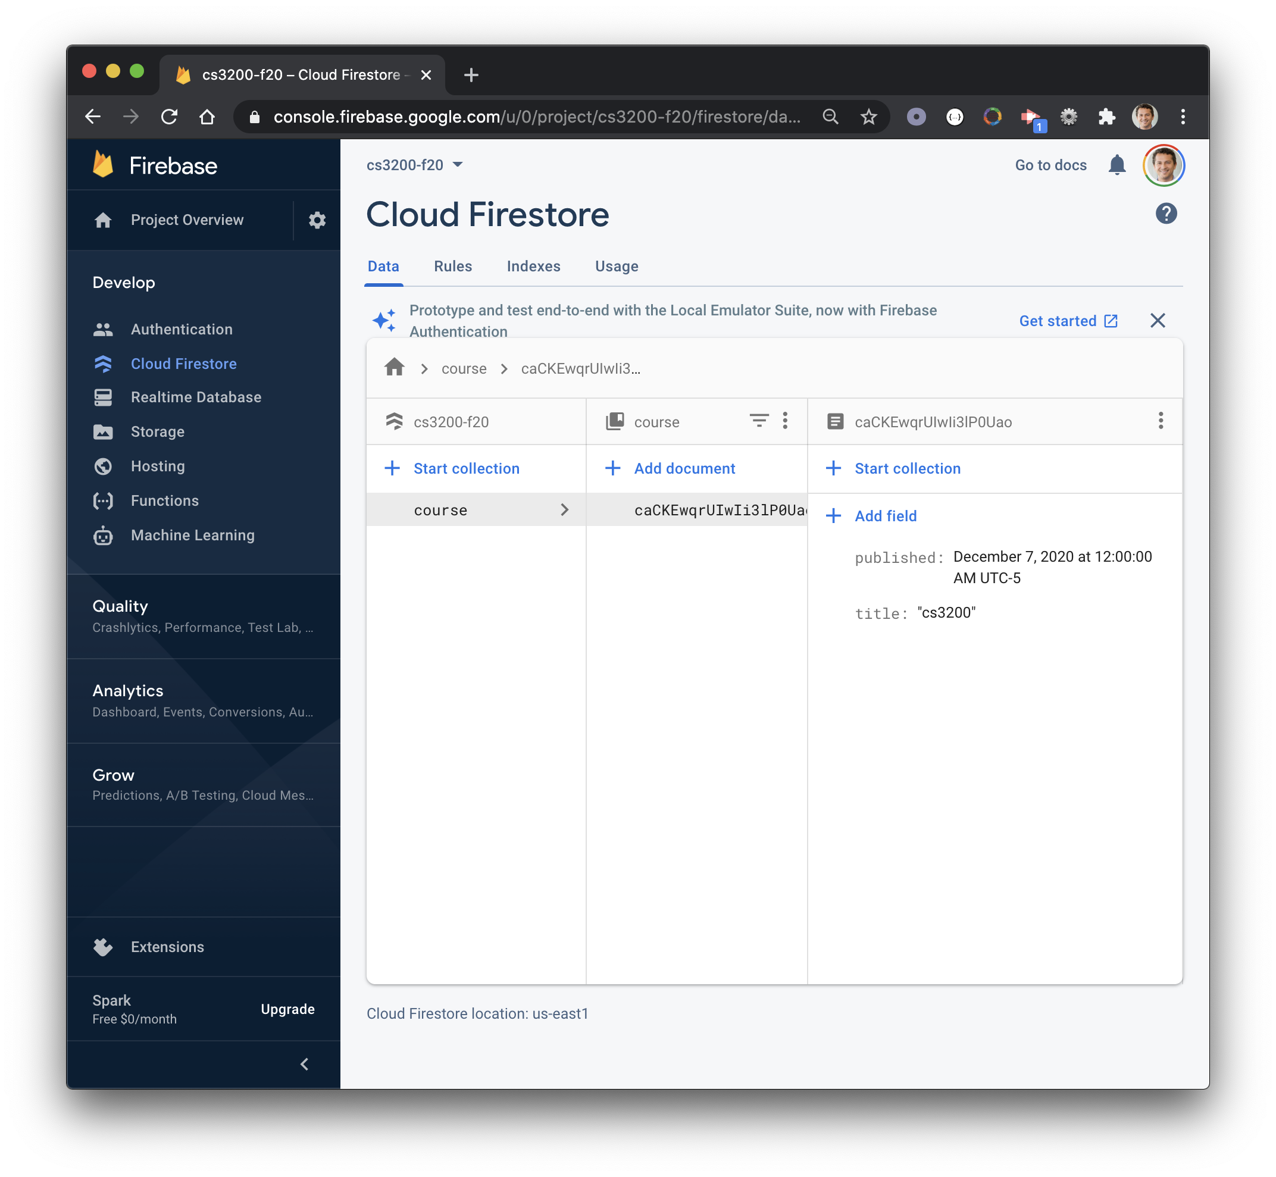
7
2
5
6
3
Add fields, set type / value
1
4

Slide 19
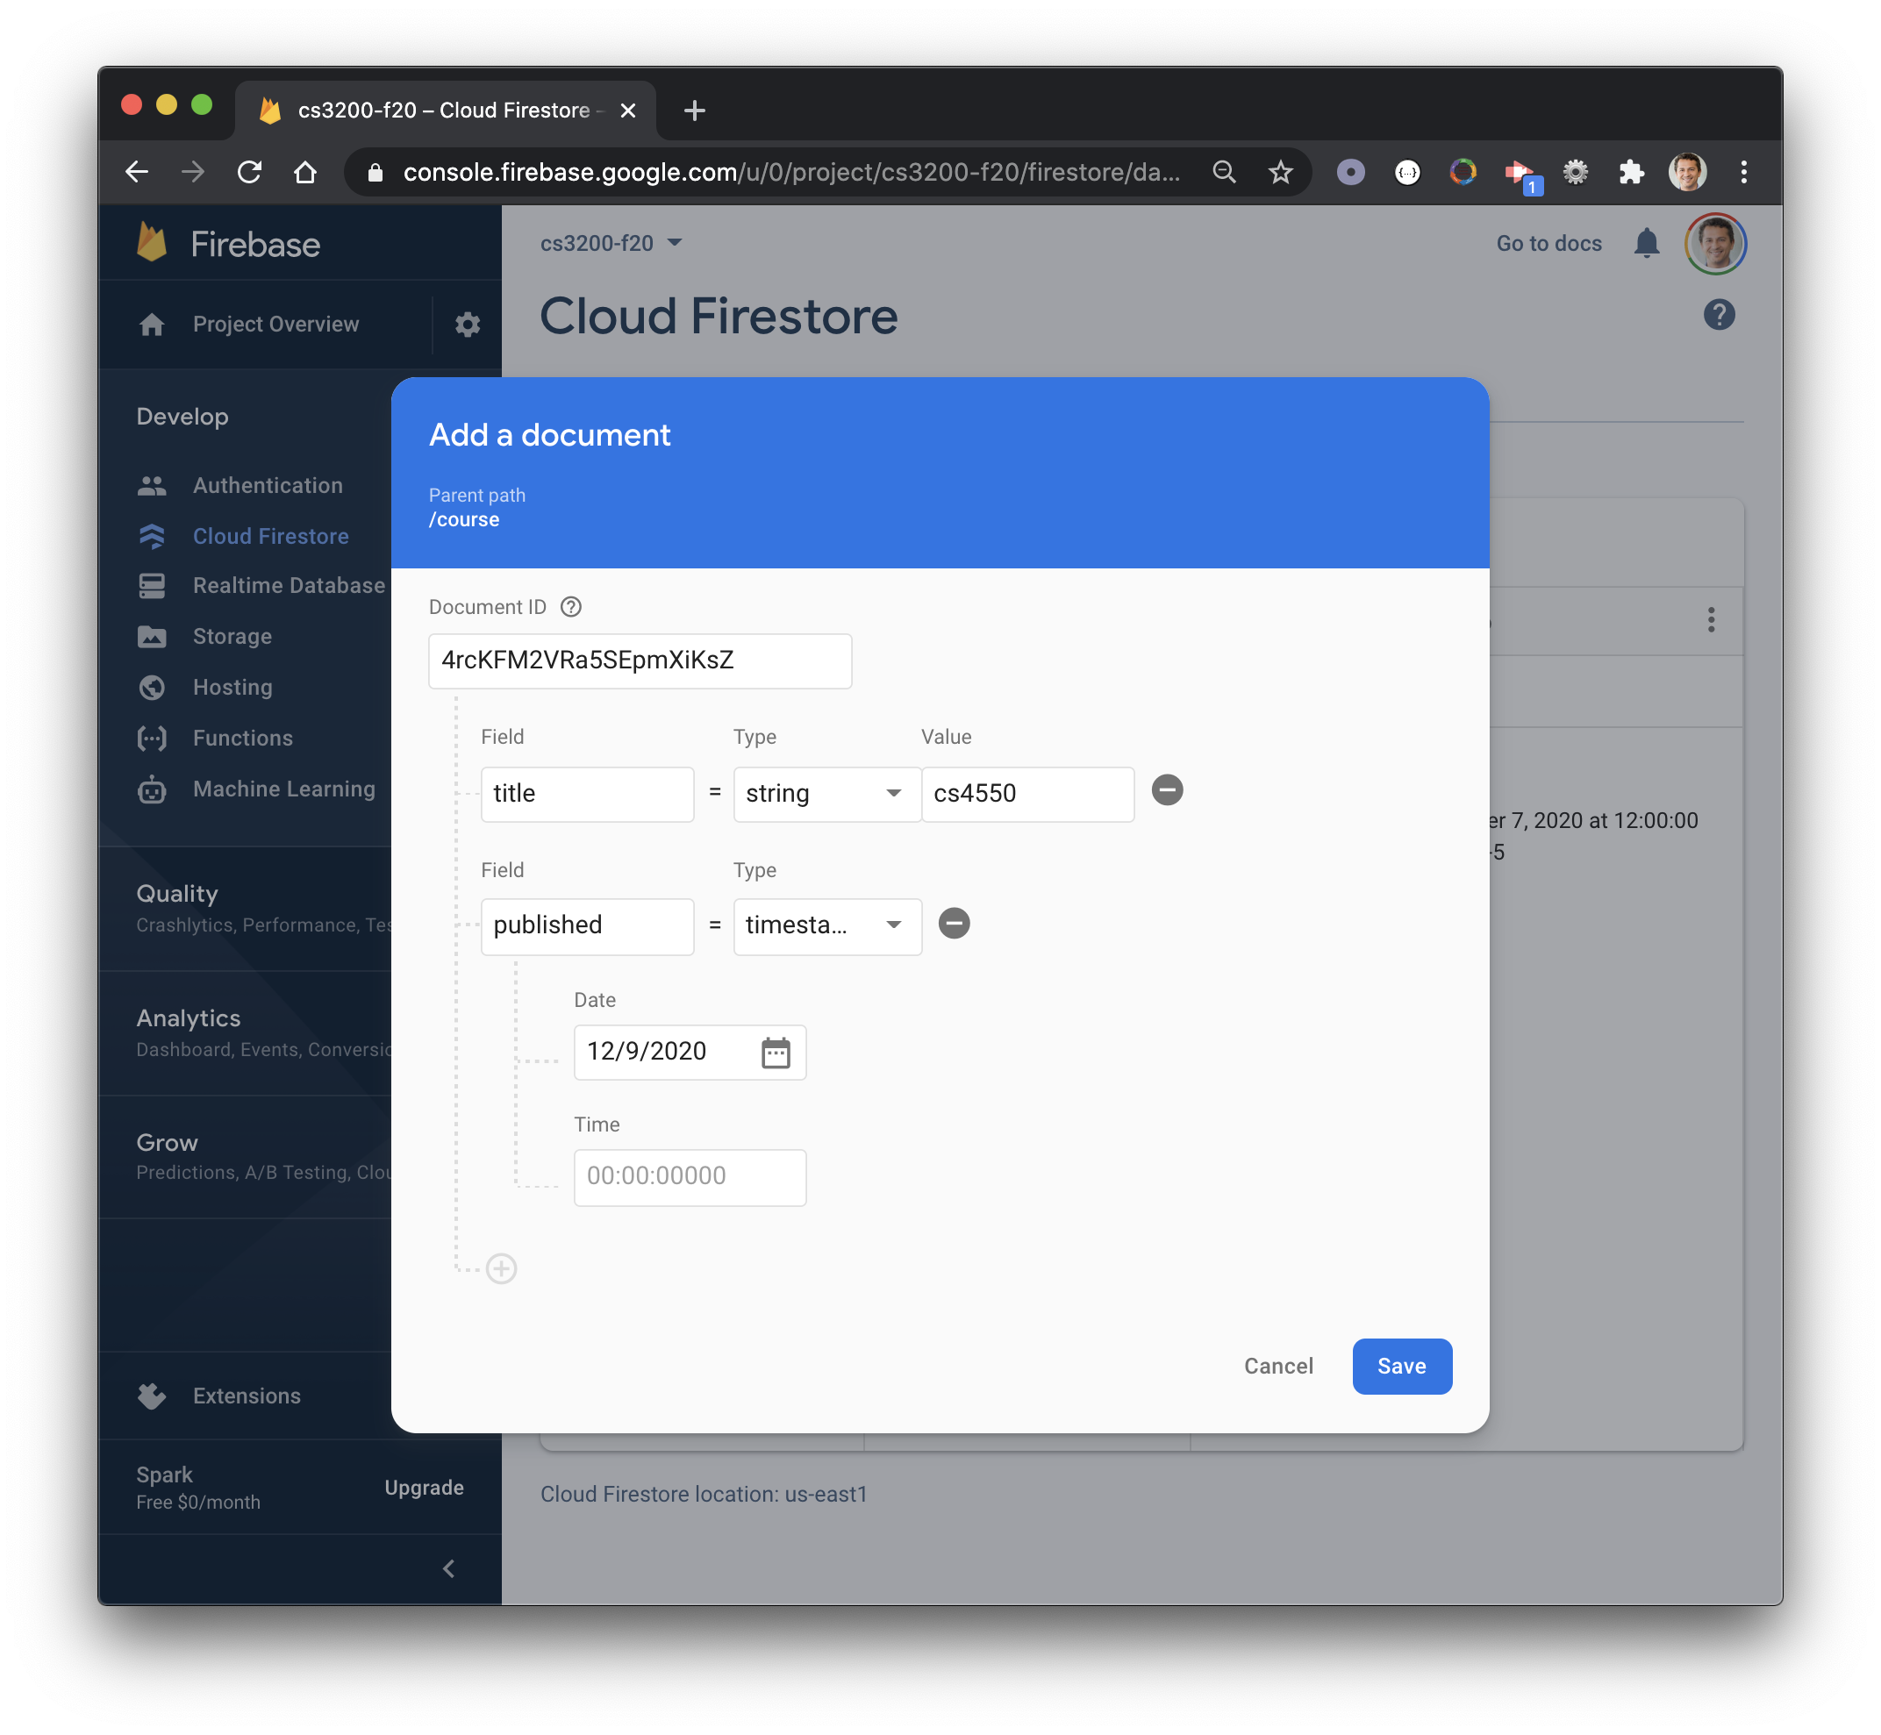

2
1
6
3
4
Adding new documents
5

Slide 20
Integrating Firestore with JavaScript

Slide 21
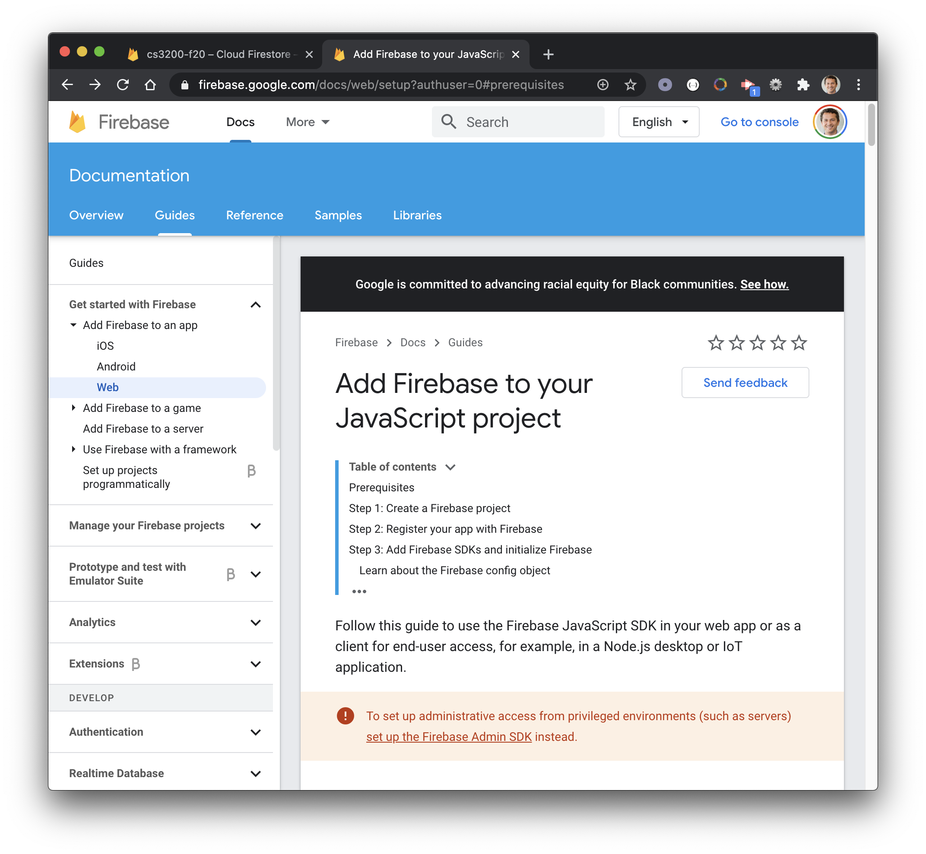
Add Firebase to your
JavaScript project

Slide 22
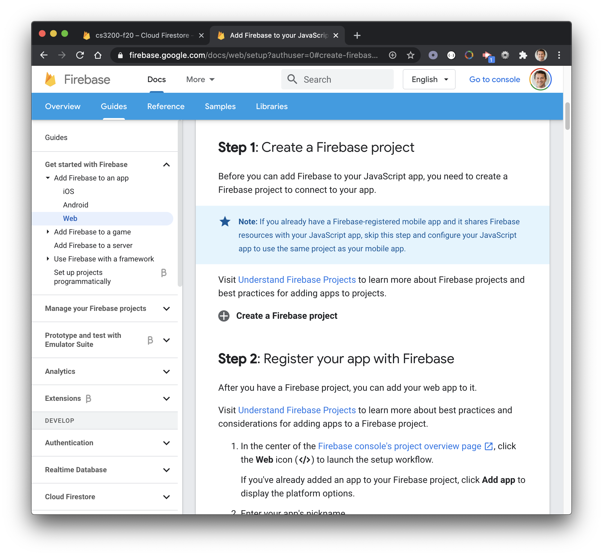
Create a Firebase
project

Slide 23
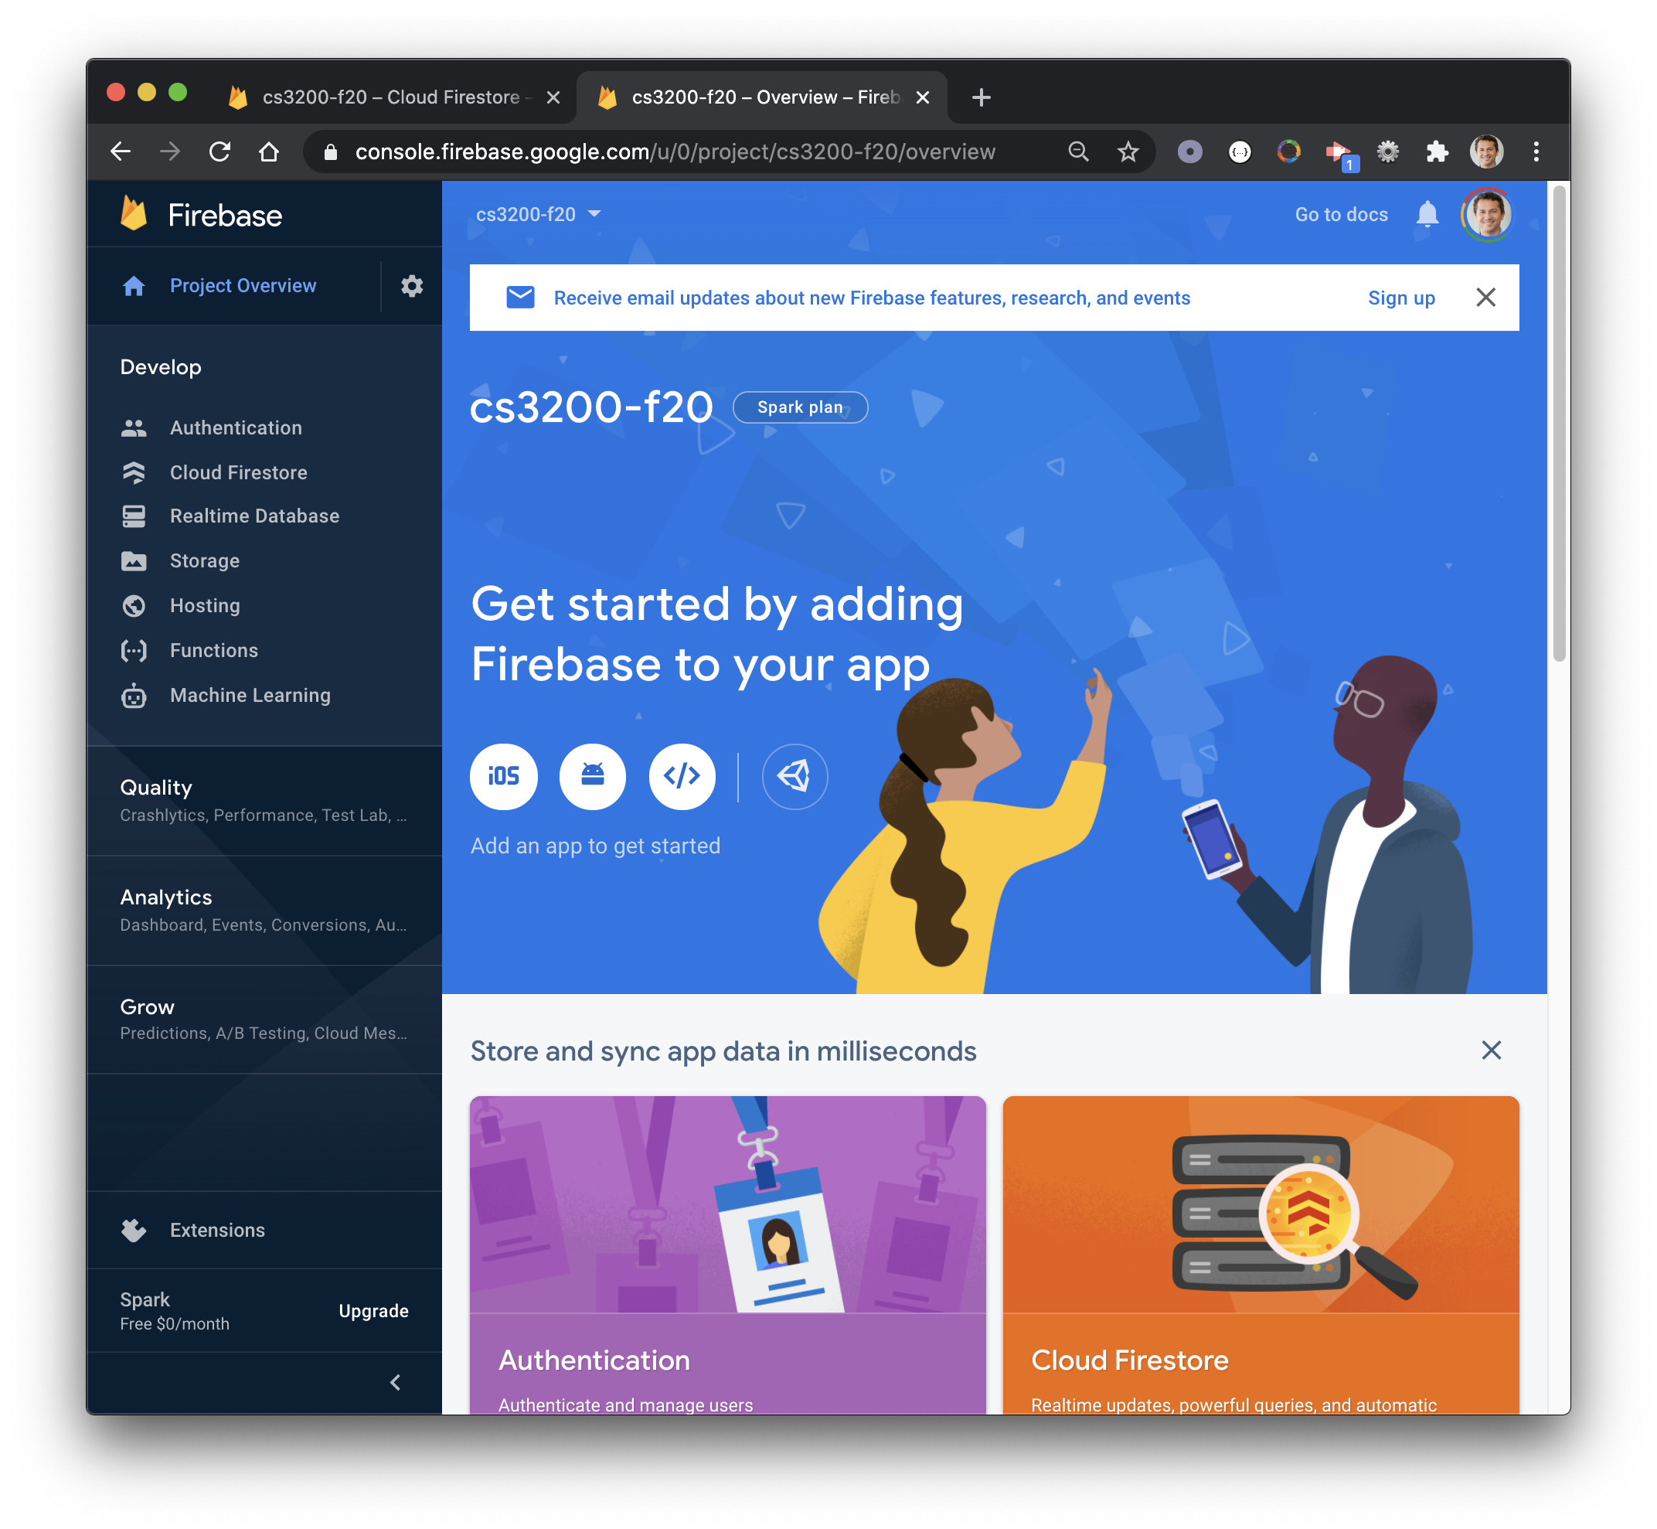
1

Slide 24
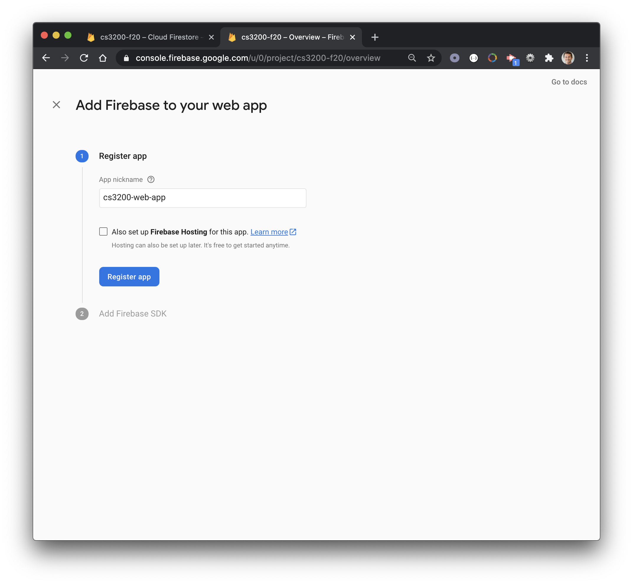
1
2

Slide 25
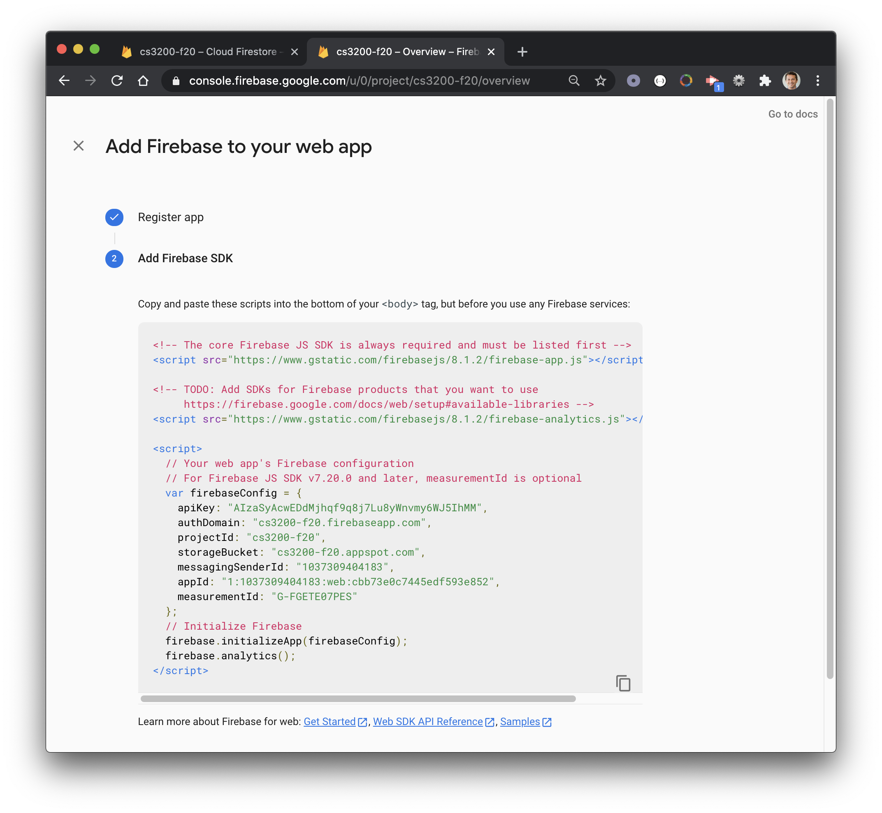
Hidden for privacy

Slide 26
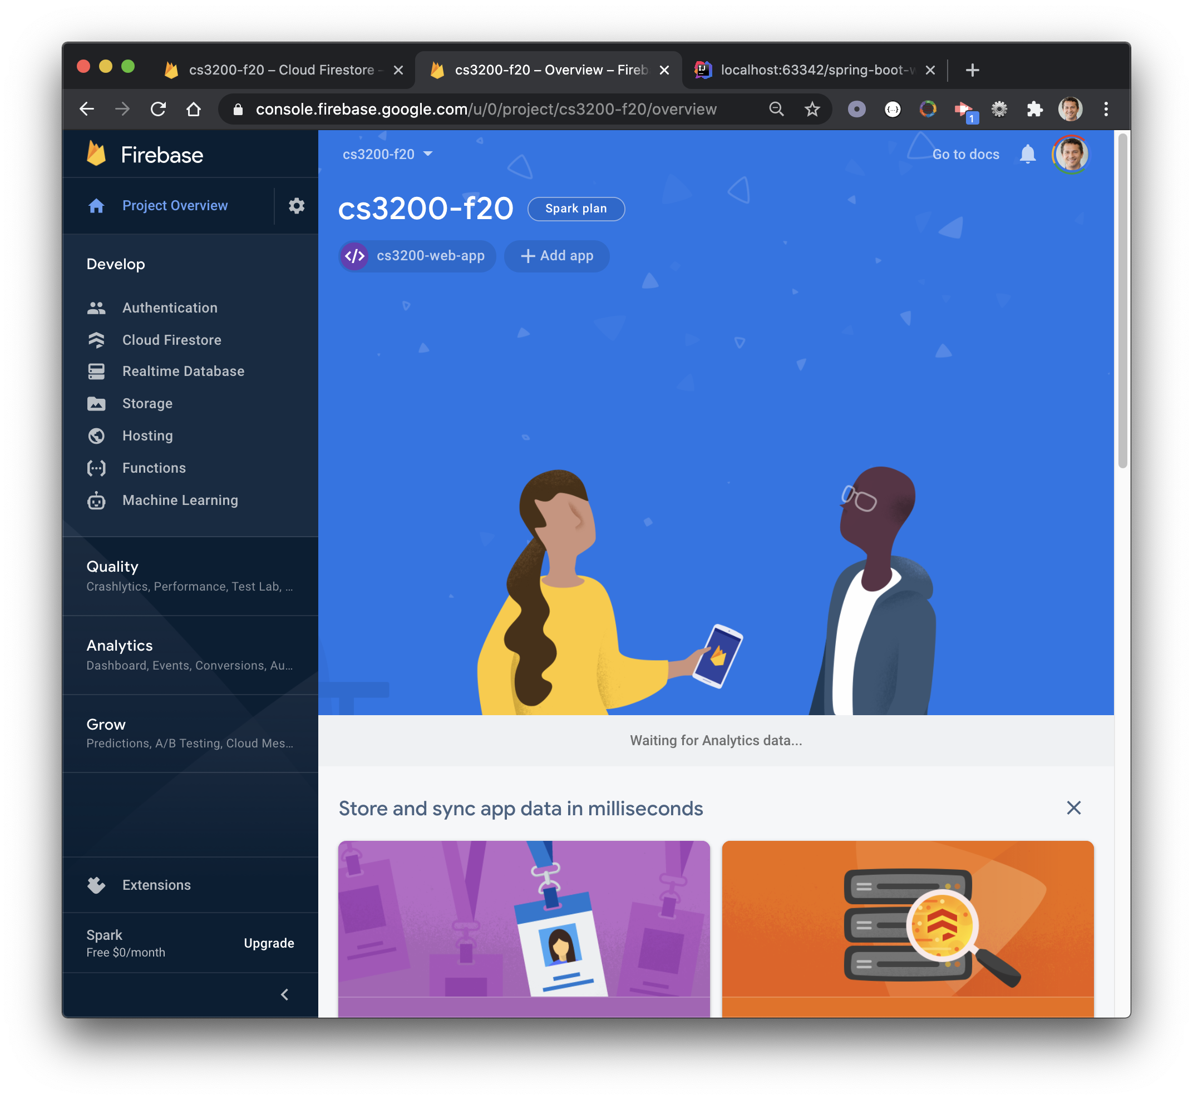
1

Slide 27
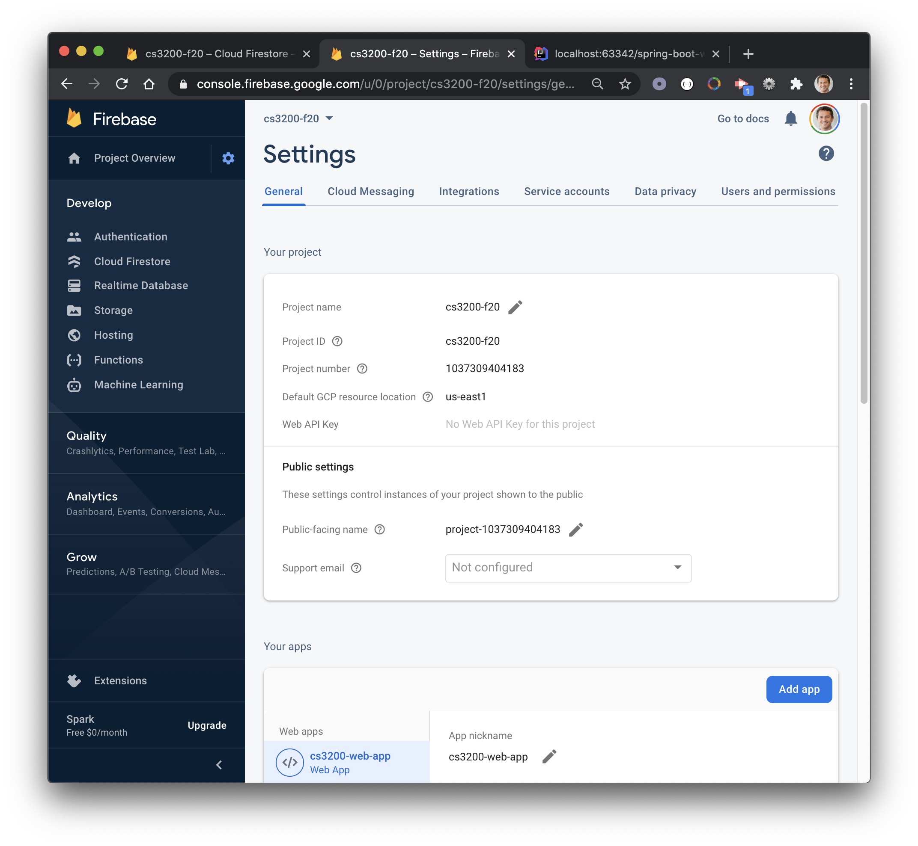

Slide 28
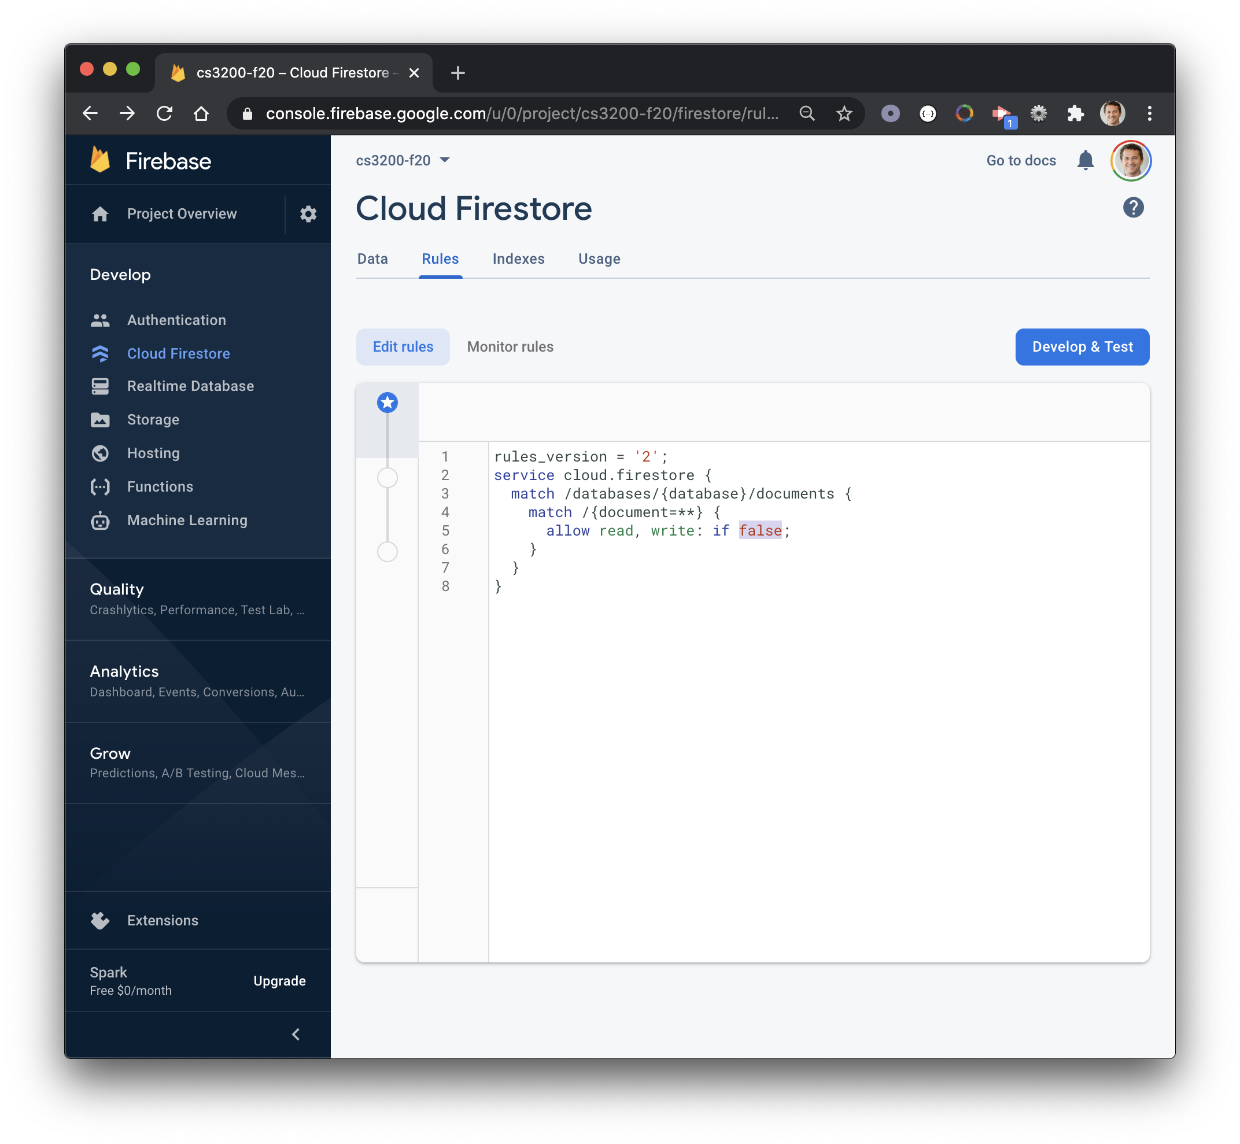
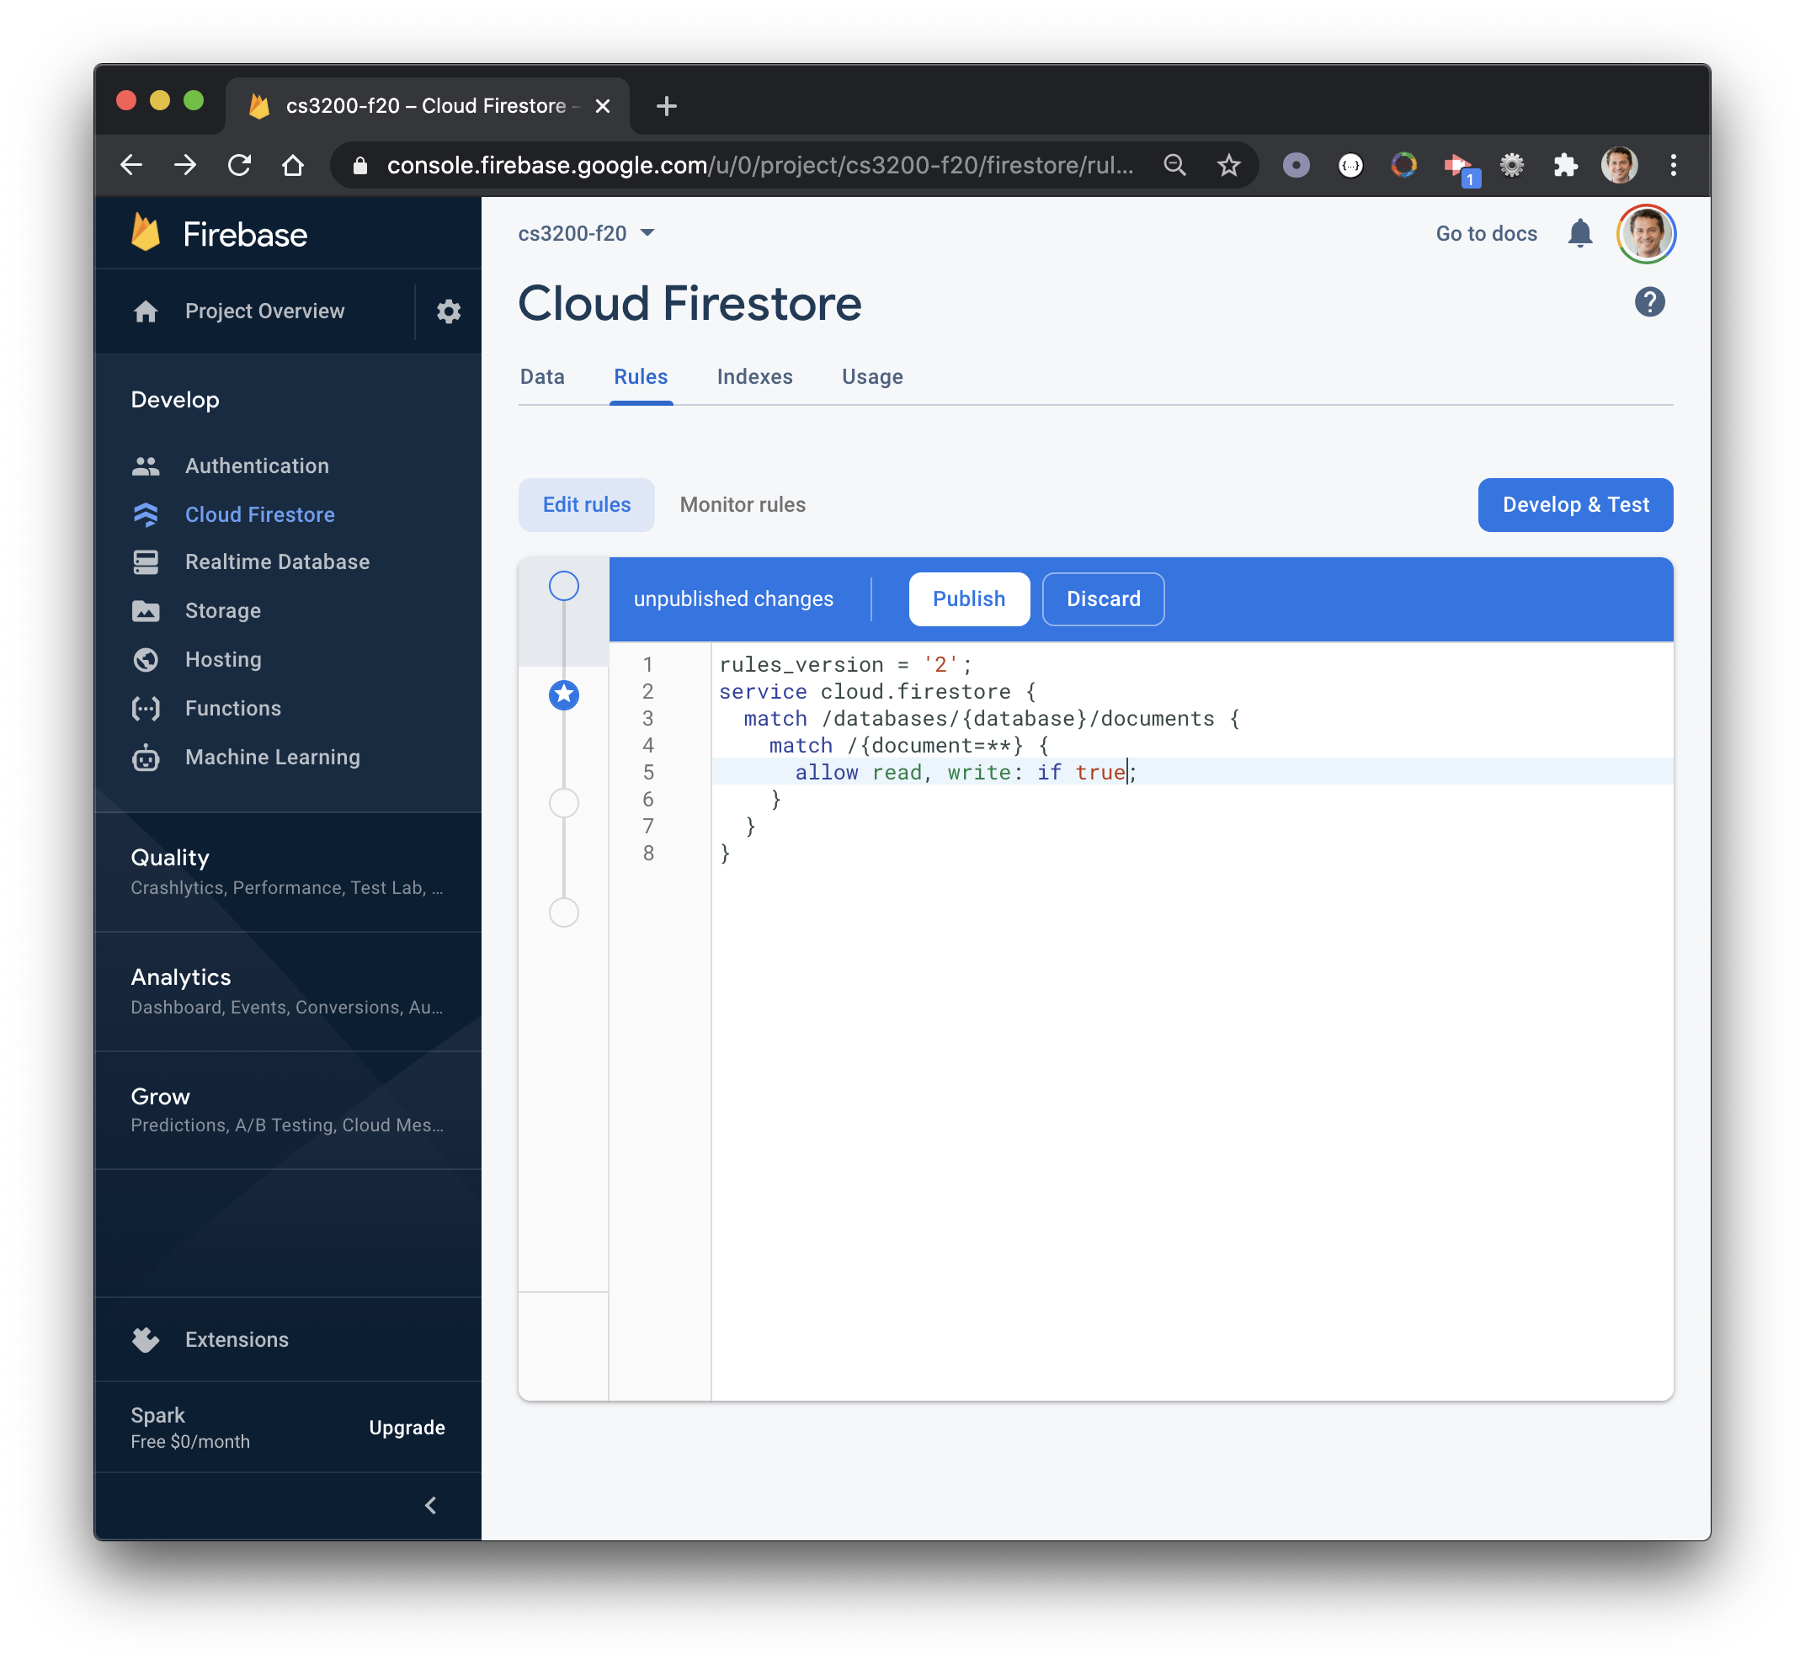

Slide 29
Integrating Firestore with React.js

Slide 30
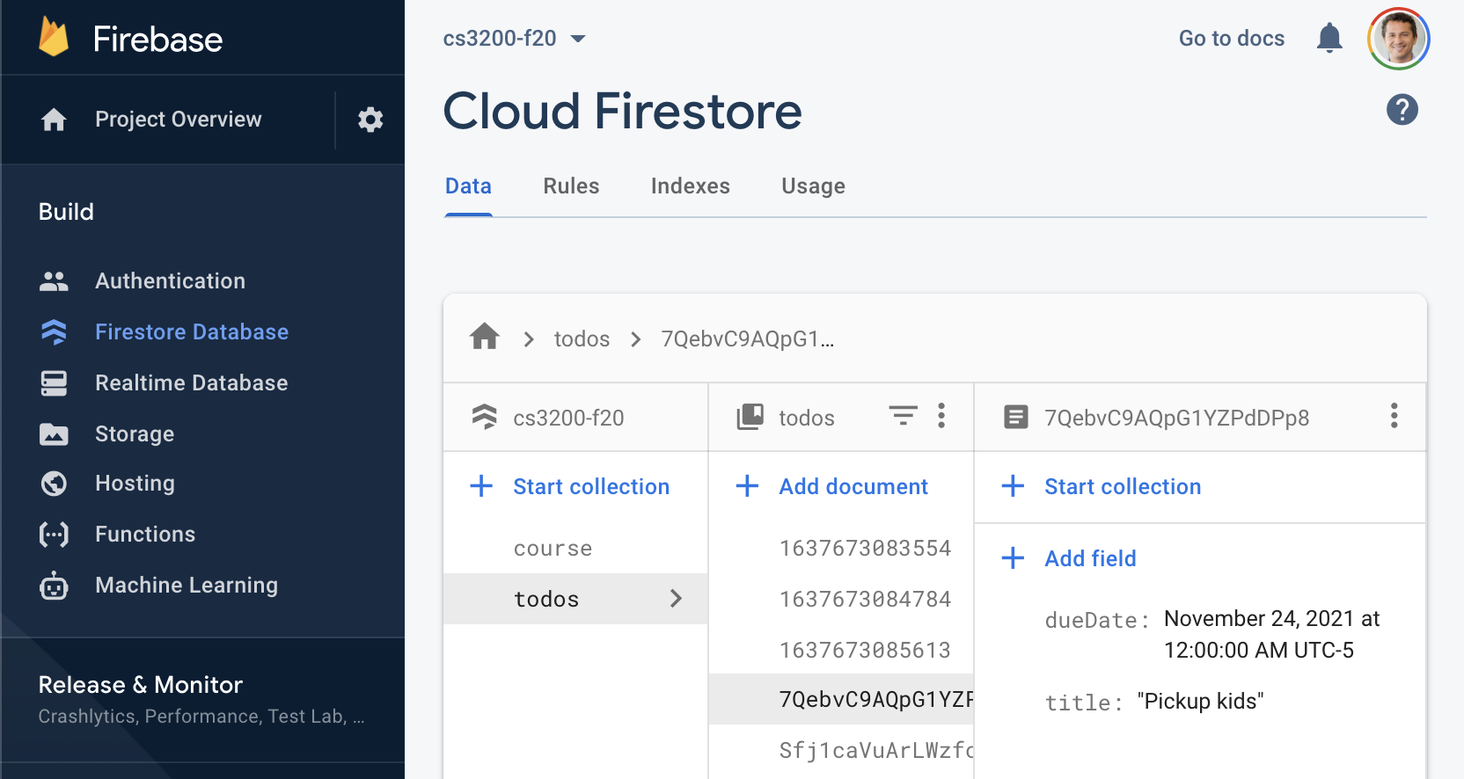
Creating a collection in Firebase

Slide 31
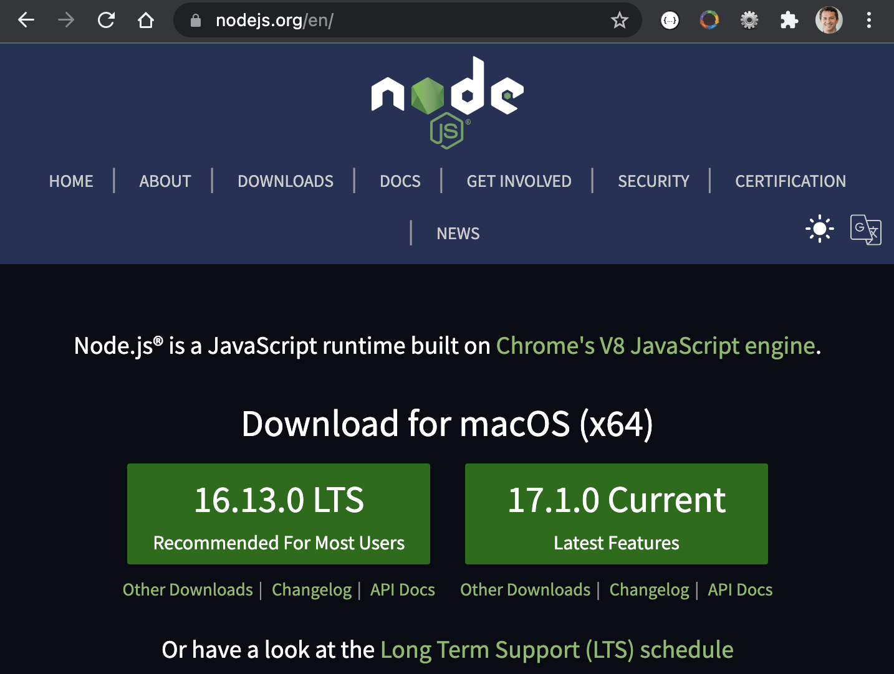
Installing Node.js
Navigate to https://nodejs.org/en/
Download the latest installer for your OS
Install following the instructions
Restart your computer

Slide 32
Creating a React Application
Use npx create-react-app to create a new React app
npx create-react-app my-app
Start from the root of the new application
cd my-app
npm start

Slide 33
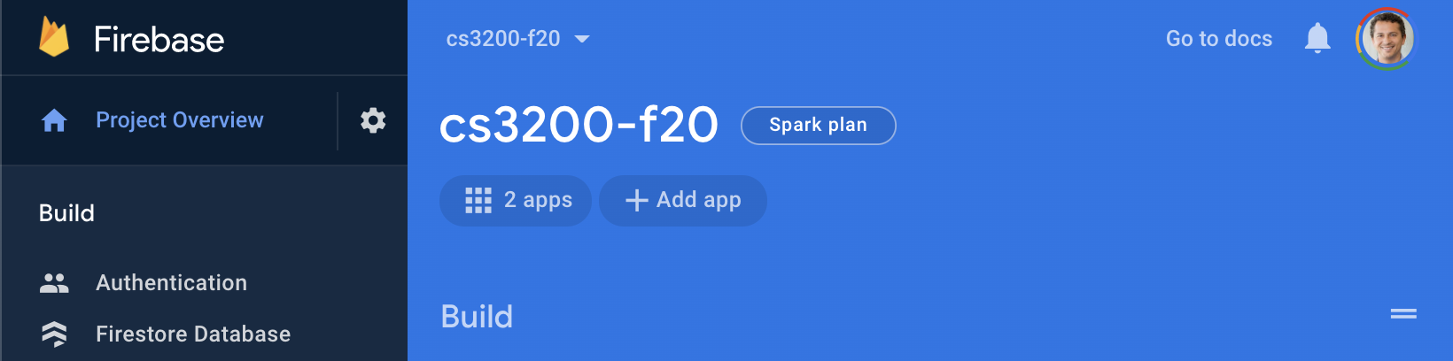
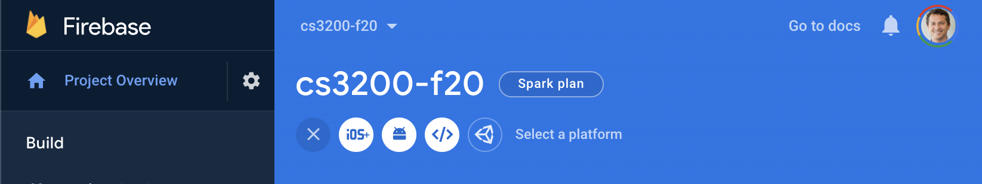
Creating a new Firebase App
Create a new Firebase App from the console
Choose a Web application

Slide 34
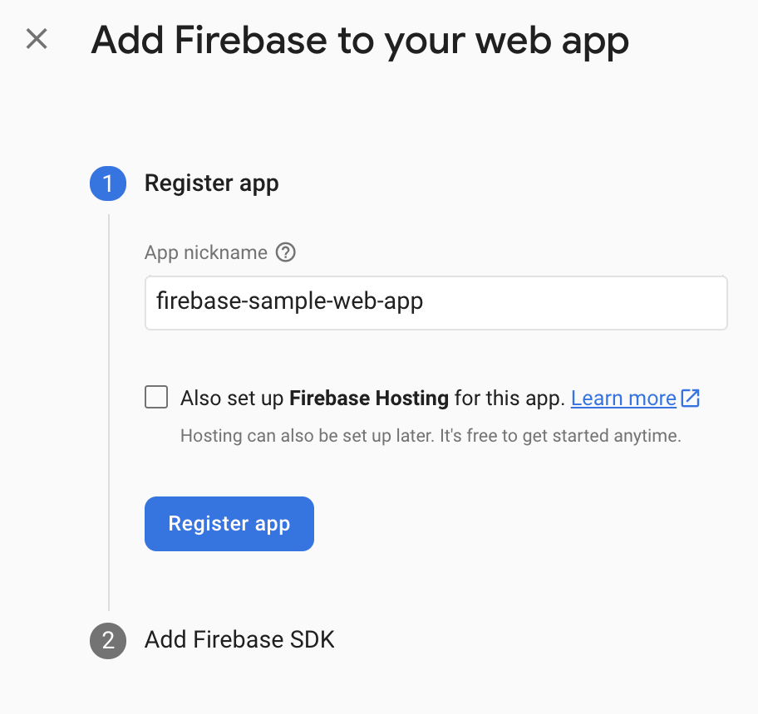
Registering a new Firebase Web App
Choose a name for the new Firebase Web App

Slide 35
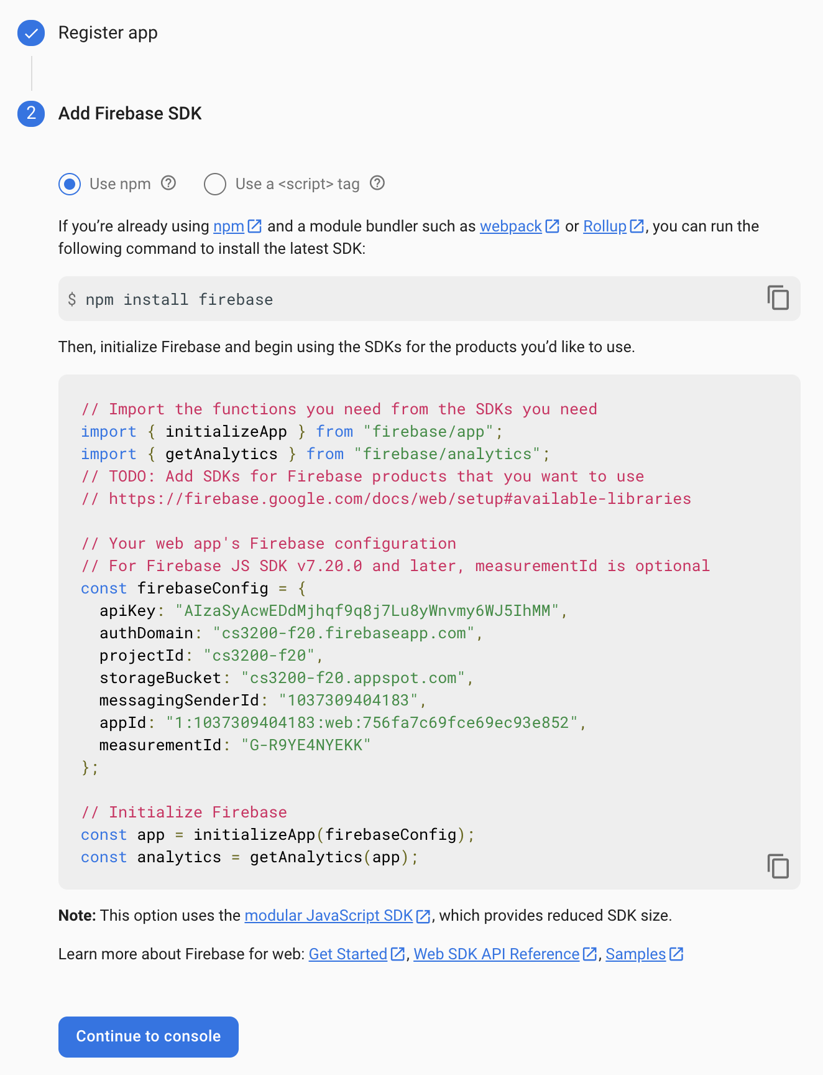
Installing Firebase libraries
At the root of the React application, install the Firebase libraries
npm install firebase
Copy the firebaseConfig code and click Continue to console
Hidden for
privacy

Slide 36
Creating a React component
Create FirebaseExample.js under src directory
import React from "react";
const FirebaseExample = () => {
return(
<div>
<h1>Firebase Example</h1>
</div>
)
}
export default FirebaseExample;

Slide 37
Rendering a React component
Import components in App.js
import FirebaseExample from "./FirebaseExample";
function App() {
return (
<div>
<FirebaseExample/>
</div>
);
}
export default App;

Slide 38
Configuring a Firebase database
Add firebase configuration to React component
const firebaseConfig = {
apiKey: "REMOVEDFORPRIVACY",
authDomain: "firebase-sample.firebaseapp.com",
projectId: "firebase-sample",
storageBucket: "firebase-sample.appspot.com",
messagingSenderId: "REMOVEDFORPRIVACY",
appId: "REMOVEDFORPRIVACY",
measurementId: "REMOVEDFORPRIVACY"
};

Slide 39
Initializing and connecting to a Firestore database
import { initializeApp } from "firebase/app";
import { getFirestore } from
'firebase/firestore/lite';
const FirebaseExample = () => {
const app = initializeApp(firebaseConfig);
const db = getFirestore(app);
}

Slide 40
Retrieving data from Firebase
import {..., collection, getDocs }
from 'firebase/firestore/lite';
const colName = 'todos';
async function getRecords(db) {
const col = collection(db, colName);
const snapshot = await getDocs(col);
const list = snapshot.docs.map(doc => {
const data = doc.data();
return {...data, id: doc.id }});
return list;
}

Slide 41
Storing data from Firebase to React state variables
import React, {useEffect, useState} from "react";
const FirebaseExample = () => {
...
const [records, setRecords] = useState([]);
useEffect(() => {
getRecords(db)
.then(records => setRecords(records));
}, []);
...
}

Slide 42
Rendering data from Firebase
return(
<div>
<h1>Firebase Example</h1>
<ul>
{ records.map((record, ndx) =>
<li key={record.id}>
{record.title}
</li>
)}
</ul>
</div>);

Slide 43
Inserting data into a Firebase collection
import {setDoc,doc} from 'firebase/firestore/lite';
...
async function insertRecord(db) {
const id = (new Date()).getTime() + '';
const newRecord = {
title: 'New Record ' + id, id };
const ref = doc(db, colName, id);
await setDoc(ref, newRecord);
setRecords([newRecord, ...records]);
}

Slide 44
Adding a Create button
Add a button to invoke our new insertRecord() function
<button onClick={() => insertRecord(db)}>
Create
</button>
Click the new Create button and confirm new Todos are created

Slide 45
Deleting data from Firebase
import { deleteDoc } from 'firebase/firestore/lite';
...
async function deleteRecord(db, id) {
await deleteDoc(doc(db, colName, id));
setRecords(
records.filter(record => record.id !== id)
);
}

Slide 46
Adding a Delete button to each item
<ul>
{ records.map((record, ndx) =>
<li key={record.id}>
<button onClick={
() => deleteRecord(db, record.id)}>
Delete</button>
{record.title}
</li>
)
}
</ul>

Slide 47
Updating a Firebase document
const [editingRecord, setEditingRecord] = useState({});
<li key={record.id}>
<button onClick={
() => deleteRecord(db, record.id)}>
Delete</button>
<button onClick={
() => setEditingRecord(record)}>
Edit</button>
{record.title}
</li>

Slide 48
Editing a document field with a form element
<input
value={editingRecord.title}
onChange={(e) =>
setEditingRecord({
...editingRecord,
title: e.target.value})}/>

Slide 49
Updating a document in Firebase
async function updateRecord(db) {
const ref = doc(db, colName, editingRecord.id);
await setDoc(ref, editingRecord);
setRecords(
records.map(record => record.id ===
editingRecord.id ? editingRecord : record)
);
}
...
<button onClick={() => updateRecord(db)}>
Update</button>

Slide 50
Integrating Firestore with Node.js

Slide 51
Create a Node.js project & Install Firebase
Create a Node.js application in a directory of choice
mkdir myApp
cd myApp
npm init
Accept all defaults and then install firebase admin
npm install firebase --save

Slide 52
firebase-config.json
{
"apiKey": "...",
"authDomain": "...",
"projectId": "...",
"storageBucket": "...",
"messagingSenderId": "...",
"appId": "...",
"measurementId": "..."
}

Slide 53
firebase.js
const firebase = require("firebase/app");
require("firebase/firestore");
const firebaseConfig = require("./firebase-config.json")
firebase.initializeApp(firebaseConfig);

Slide 54
Retrieve all documents
const db = firebase.firestore();
db.collection('courses')
.get()
.then(snapshot =>
snapshot.docs
.forEach(course => console.log(course.data())))

Slide 55
Retrieve a document by ID
db.collection('courses')
.doc('4rcKFM2VRa5SEpmXiKsZ')
.get()
.then(course => {
console.log(course.data())
})

Slide 56
Retrieve a document by field
db.collection('courses')
.where('title', '==', 'cs3200')
.get()
.then(snapshot =>
snapshot.docs
.forEach(course => console.log(course.data())))

Slide 57
Insert a new document with ID
db.collection('courses')
.doc('newCourse2345')
.set({
title: 'cs2345',
published: '2020-12-23'
})

Slide 58
Insert a new document with Auto-ID
db.collection('courses')
.add({
title: 'cs3456',
published: '2020-12-23'
}).then(course => {
console.log(course.id)
})

Slide 59
Merging
If document doesn't exist, it will be created, otherwise overwritten with new data, unless specify merge
db.collection('courses')
.doc('newCourse2345')
.set({title: 'cs5432'},
{merge: true})
If unsure whether document exists, pass merge option to avoid overwriting entire documents

Slide 60
Creating a document and setting later
You can create document reference with an auto-generated ID, then use the reference later. For this use case, you can call doc():
let newCityRef = db.collection('courses').doc();
// Later...
let setDoc = newCityRef.set({ … });

Slide 61
Update a document
To update some fields of a document without overwriting the entire document, use the update() method
let ref = db.collection('courses').doc('newCourse2345');
// Set the 'published' field of the course
let updateSingle = ref.update(
{published: '2020-01-')});

Slide 62
THE END

Slide 63
Integrating Firestore with Node.js

Slide 64
Create a Node.js project & Install Firebase
Create a Node.js application in a directory of choice
mkdir myApp
cd myApp
npm init
Accept all defaults and then install firebase admin
npm install firebase-admin --save

Slide 65
sak.json (Service Account Key File)
{
"type": "...",
"project_id": "...",
"private_key_id": "...",
"private_key": "...",
"client_email": "...",
"client_id": "...",
"auth_uri": "...",
"token_uri": "...",
"auth_provider_x509_cert_url": "...",
"client_x509_cert_url": "..."
}
This is the JSON key file created earlier when setting up the service account

Slide 66
In fb.js, create a simple Node.js app to test firebase
const admin = require('firebase-admin');
let sa = require('./sak.json');
admin.initializeApp({
credential: admin.credential.cert(sa)
});
let db = admin.firestore();

Slide 67
In fb.js, retrieve data from collection in firebase
db.collection('movies').get()
.then((snapshot) => {
snapshot.forEach((doc) => {
console.log(doc.id, '=>', doc.data());
});
})
.catch((err) => {
console.log('Error getting documents', err);
});

Slide 68
Movies on the Console
0jcXPNADLLFvN6ru7AqG =>
{ rating: 'PG-13', title: 'Avatar' }
DSo0iQTdgU93pwWIhG9C =>
{ rating: 'R', title: 'Terminator 2' }
WM09l3QeQmk25wh4Lw2P =>
{ rating: 'PG-13', title: 'Titanic' }
zx3iHdwVgCMgT3Gcw4Rb =>
{ title: 'Aliens', rating: 'R' }

Slide 69
DEMO
server.js

Slide 70
INTERACTING
w/ FIRESTORE
FROM NODE.JS

Slide 71
Reading Data from Firestore with Node.js

Slide 72
Get data with Cloud Firestore
Two ways to retrieve data stored in Cloud Firestore
Both can be used with documents, collections of documents, or the results of queries:
Call a method to get the data.
Set a listener to receive data-change events.
When you set a listener, Cloud Firestore sends your listener an initial snapshot of the data, and then another snapshot each time the document changes.

Slide 73
Get a document by ID with doc()
let cityRef = db.collection('cities').doc('SF');
let getDoc = cityRef.get()
.then(doc => {
if (!doc.exists) {
console.log('No such document!');
} else {
console.log('Document data:', doc.data());
}
})

Slide 74
Get multiple documents from collection with where
let citiesRef = db.collection('cities');
let query = citiesRef.where('capital', '==', true).get()
.then(snapshot => {
if (snapshot.empty) {
console.log('No matching documents.');
return;
}
snapshot.forEach(doc => {
console.log(doc.id, '=>', doc.data());
});})

Slide 75
Get all documents in a collection
Retrieve all documents in a collection by omitting where()
let citiesRef = db.collection('cities');
let allCities = citiesRef.get()
.then(snapshot => {
snapshot.forEach(doc => {
console.log(doc.id, '=>', doc.data());
});
})

Slide 76
List subcollections with getCollections()
The getCollections() method of the Cloud Firestore server client libraries lists all subcollections of a document reference.
let sfRef = db.collection('cities').doc('SF');
sfRef.listCollections().then(collections => {
collections.forEach(collection => {
console.log('Found subcollection with id:',
collection.id);
});
});

Slide 77
DEMO
findAll(), findById()

Slide 78
Adding Data to Firestore with Node.js

Slide 79
Set a document with set()
To create or overwrite a single document, use the set() method:
db.collection('cities')
.doc('new-city-id')
.set(data);

Slide 80
Set a document
To create or overwrite a single document, use the set() method:
let data = {
name: 'New York', state: NY, country: 'USA'
};
// Add new document in collection "cities" with ID 'NY'
let setDoc = db.collection('cities').doc('NY').set(data);

Slide 81
Autogenerated ID with add()
If no meaningful ID, let Cloud Firestore auto-generate ID. Use add() instead:
db.collection('cities').add({
name: 'Tokyo', country: 'Japan'
}).then(ref => {
console.log('Added document with ID: ', ref.id);
});

Slide 82
Merging
If document doesn't exist, it will be created, otherwise overwritten with new data, unless specify merge
db.collection('cities')
.doc('Yonkers')
.set({capital: false},
{merge: true})
If unsure whether document exists, pass merge option to avoid overwriting entire documents

Slide 83
Creating a document and setting later
You can create document reference with an auto-generated ID, then use the reference later. For this use case, you can call doc():
let newCityRef = db.collection('cities').doc();
// Later...
let setDoc = newCityRef.set({ … });

Slide 84
Update a document
To update some fields of a document without overwriting the entire document, use the update() method
let cityRef = db.collection('cities').doc('DC');
// Set the 'capital' field of the city
let updateSingle = cityRef.update({capital: true});

Slide 85
Server Timestamp
You can set a field in your document to a server timestamp which tracks when the server receives the update.
// Get the `FieldValue` object
let FieldValue = require('firebase-admin').firestore.FieldValue;
// Create a document reference
let docRef = db.collection('objects').doc('some-id');
// Update the timestamp field with the value from the server
let updateTimestamp = docRef.update({
timestamp: FieldValue.serverTimestamp()});

Slide 86
Update fields in nested objects
Use "dot notation" to reference nested fields within the document when you call update():
let initialData = {
name: 'Frank', age: 12,
favorites: {
food: 'Pizza', color: 'Blue', subject: 'recess' }};
let updateNested = db.collection('users').doc('Frank').update({
age: 13,
'favorites.color': 'Red'});

Slide 87
Update array with arrayUnion & arrayRemove
let admin = require('firebase-admin');
let washingtonRef = db.collection('cities').doc('DC');
// Atomically add a new region to the "regions" array field.
let arrUnion = washingtonRef.update({
regions: admin.firestore.FieldValue.arrayUnion('greater_virginia')
});
// Atomically remove a region from the "regions" array field.
let arrRm = washingtonRef.update({
regions: admin.firestore.FieldValue.arrayRemove('east_coast')
});

Slide 88
DEMO
create(), update()

Slide 89
Deleting Data from Firestore with Node.js

Slide 90
Delete documents
Delete documents
let deleteDoc =
db.collection('cities').doc('DC').delete();

Slide 91
Delete fields
To delete specific fields from a document, use the FieldValue.delete() method when you update a document:
// Get the `FieldValue` object
let FieldValue = require('firebase-admin').firestore.FieldValue;
// Create a document reference
let cityRef = db.collection('cities').doc('BJ');
// Remove the 'capital' field from the document
let removeCapital = cityRef.update({
capital: FieldValue.delete() });

Slide 92
Delete collections
To delete an entire collection or subcollection in Cloud Firestore, retrieve all the documents within the collection or subcollection and delete them. If you have larger collections, you may want to delete the documents in smaller batches to avoid out-of-memory errors. Repeat the process until you've deleted the entire collection or subcollection.

Slide 93
Delete data with the Firebase CLI
You can also use the Firebase CLI to delete documents and collections. Use the following command to delete data:
firebase firestore:delete [options] <<path>>

Slide 94
DEMO
delete()

Slide 95
Realtime Updates from Firestore with Node.js

Slide 96
Get realtime updates with Cloud Firestore
You can listen to a document with the onSnapshot() method
An initial call using the callback you provide creates a document snapshot immediately with the current contents of the single document
Then, each time the contents change, another call updates the document snapshot.

Slide 97
Get realtime updates in Node.js
let doc = db.collection('cities').doc('SF');
let observer = doc.onSnapshot(docSnapshot => {
console.log(`Received doc snapshot: ${docSnapshot}`);
// ...
}, err => {
console.log(`Encountered error: ${err}`);
});

Slide 98
Listen to multiple documents in a collection
As with documents, use onSnapshot() instead of get() to listen to the results of a query. This creates a query snapshot
let query = db.collection('cities').where('state', '==', 'CA');
let observer = query.onSnapshot(querySnapshot => {
console.log(`Received query snapshot of size ${querySnapshot.size}`);
}, err => {
console.log(`Encountered error: ${err}`);
});

Slide 99
View changes between snapshots
let observer = db.collection('cities').where('state', '==', 'CA')
.onSnapshot(querySnapshot => {
querySnapshot.docChanges().forEach(change => {
if (change.type === 'added')
console.log('New city: ', change.doc.data());
if (change.type === 'modified')
console.log('Modified city: ', change.doc.data());
if (change.type === 'removed')
console.log('Removed city: ', change.doc.data());
}); });

Slide 100
Detach a listener
When you are no longer interested in listening to your data, you must detach your listener so that your event callbacks stop getting called
let unsub = db.collection('cities').onSnapshot(() => { … });
// ...
// Stop listening for changes
unsub();

Slide 101
Creating a Google Service Account

Slide 102
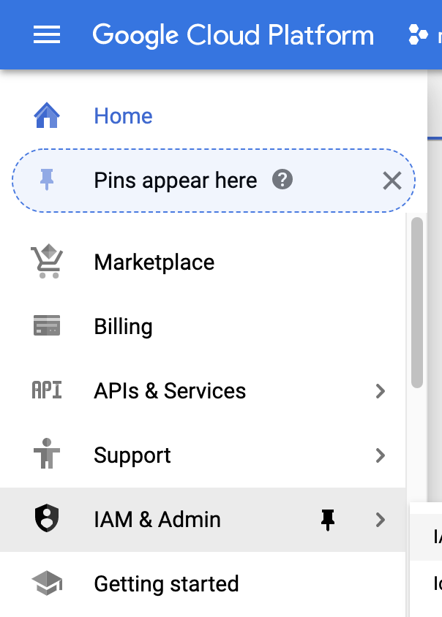
Create a Service Account in Google cloud console
Service accounts are special Google accounts that can be used by applications to access Google APIs programmatically
Navigate to the Google console
https://console.cloud.google.com/

Slide 103
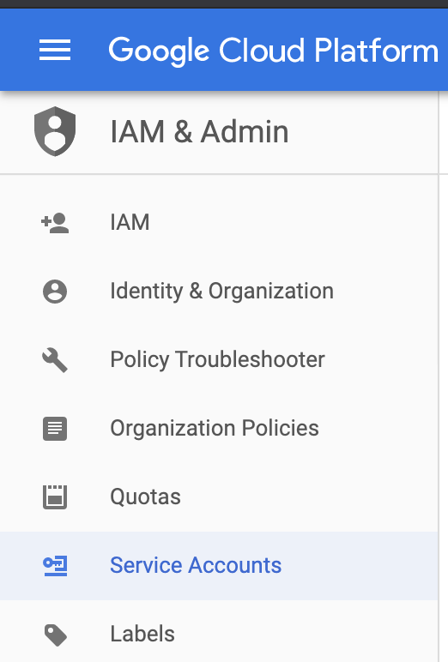
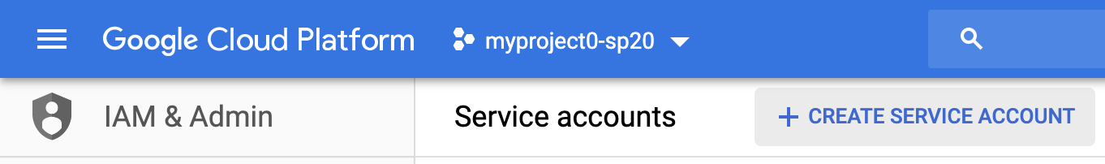
Create a Service Account
2
1

Slide 104
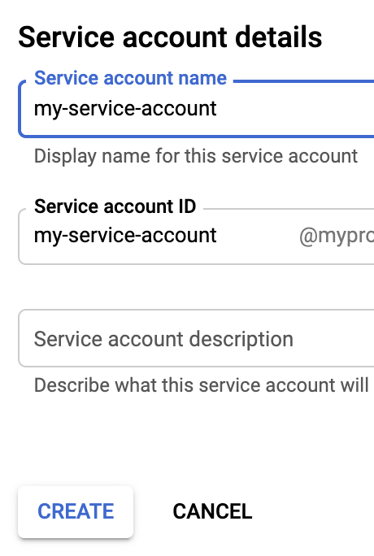
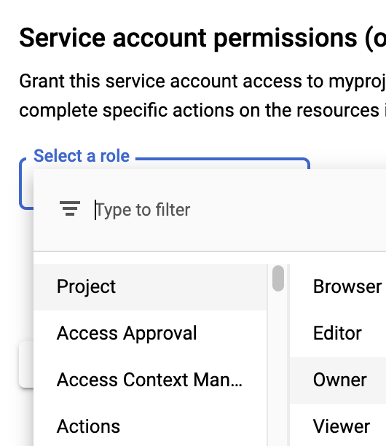
Name and permission your service account
1
3
2
4

Slide 105
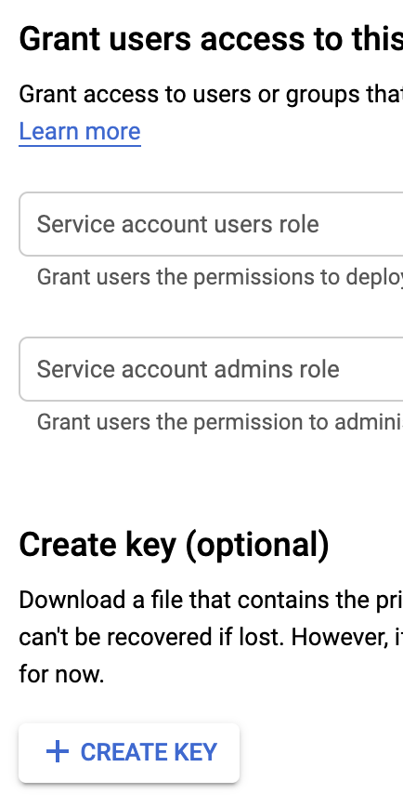
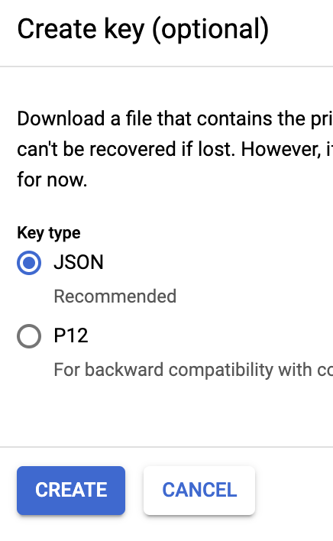
Grant access by creating a JSON key file
Download the JSON key file to the local file system
The JSON key file will be used later by a Node.js application
2
1
3

Slide 106
Creating a Firestore Database

Slide 107
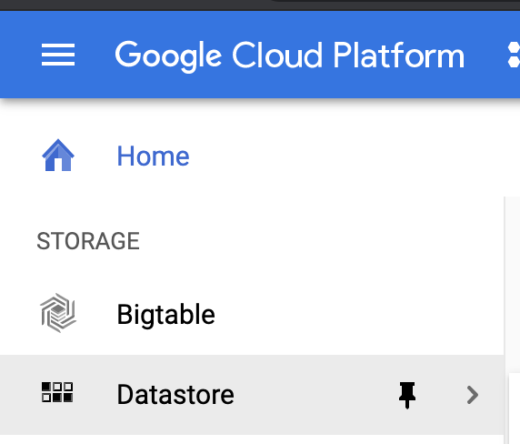
Create a Firestore database
Create a remote Firestore database linked to the service account

Slide 108
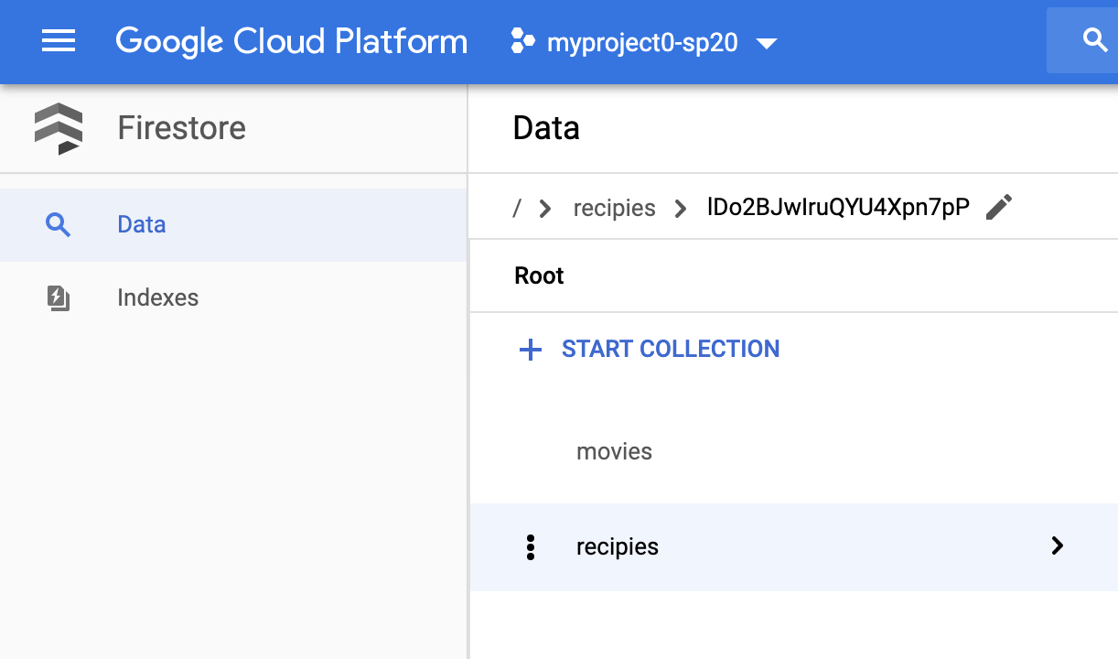
Create collections
1
2

Slide 109
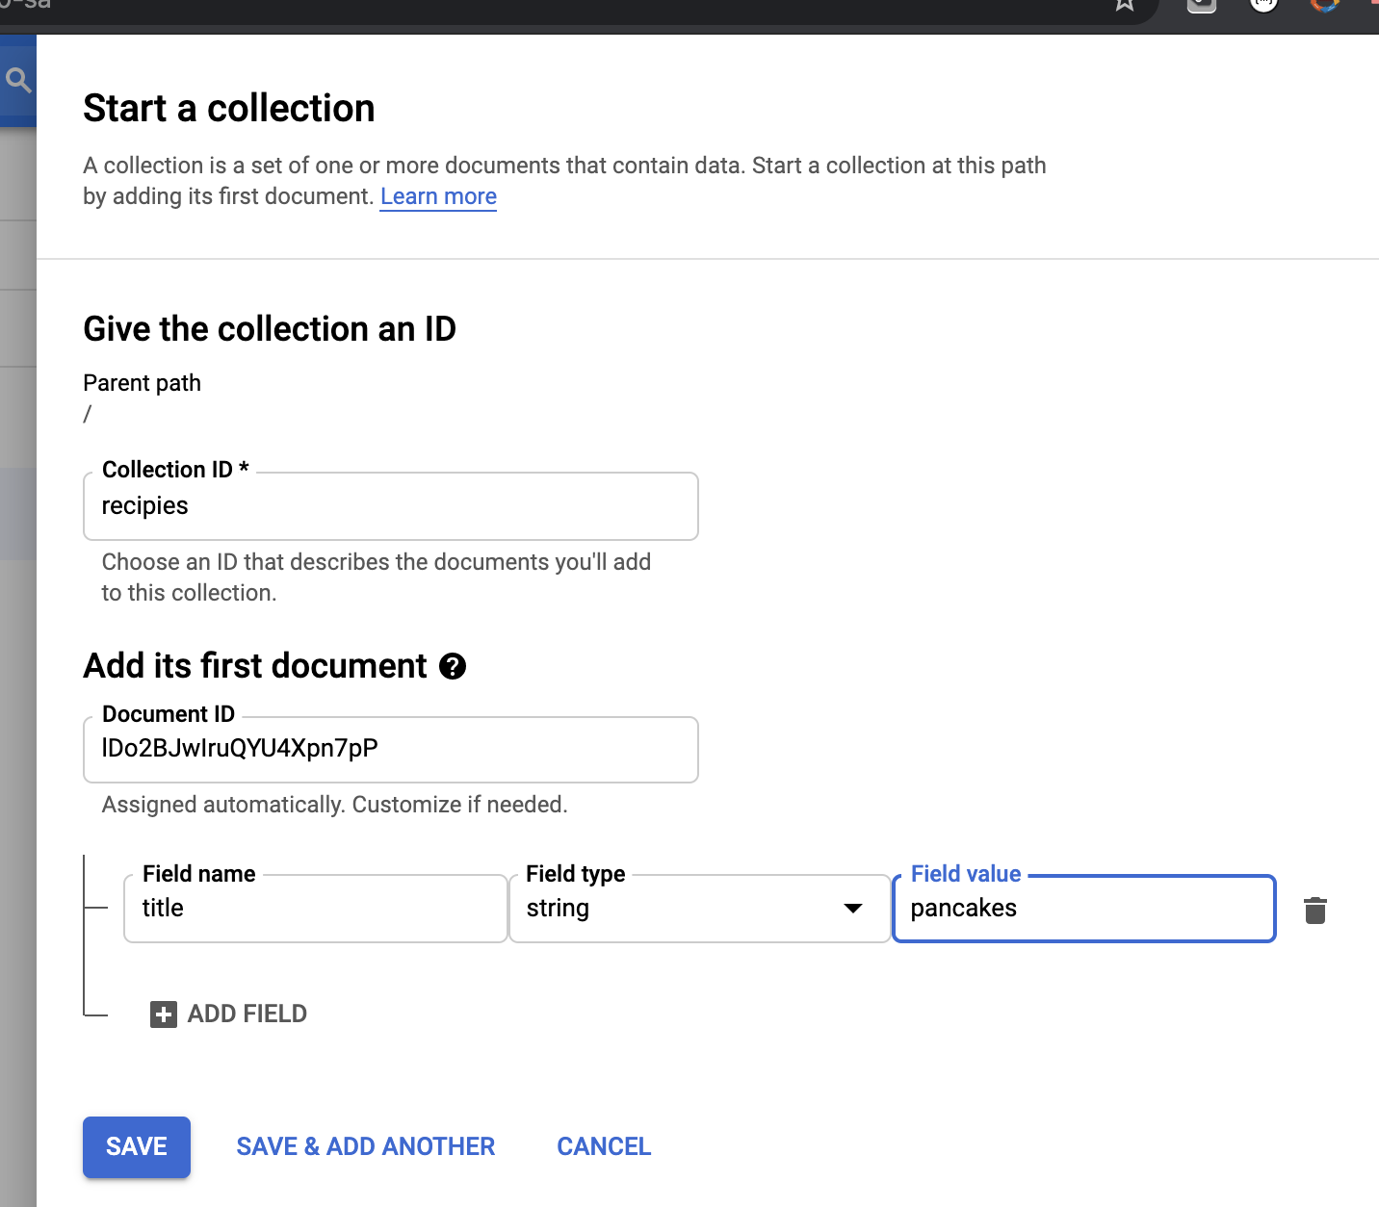
Collections
Name your collections
Add fields to each document
1
2
6
3
4
5
7

Slide 110
Collections can contain documents and collections
1
2
3

Slide 111
DEMO

Slide 112
DEMO
listenUpdates()

Slide 113
REFERENCES

Slide 114
References
https://console.firebase.google.com/
https://firebase.google.com/docs/firestore/quickstart

Slide 115
Scale across multiple databases
With Firebase Realtime Database on the Blaze pricing plan, you can support your app's data needs at scale by splitting your data across multiple database instances in the same Firebase project
Streamline authentication with Firebase Authentication on your project and authenticate users across your database instances
Control access to the data in each database with custom Firebase Realtime Database Rules for each database instance.

Slide 116
Add Firebase to your JavaScript project
Step 1: Create a Firebase project

Slide 117
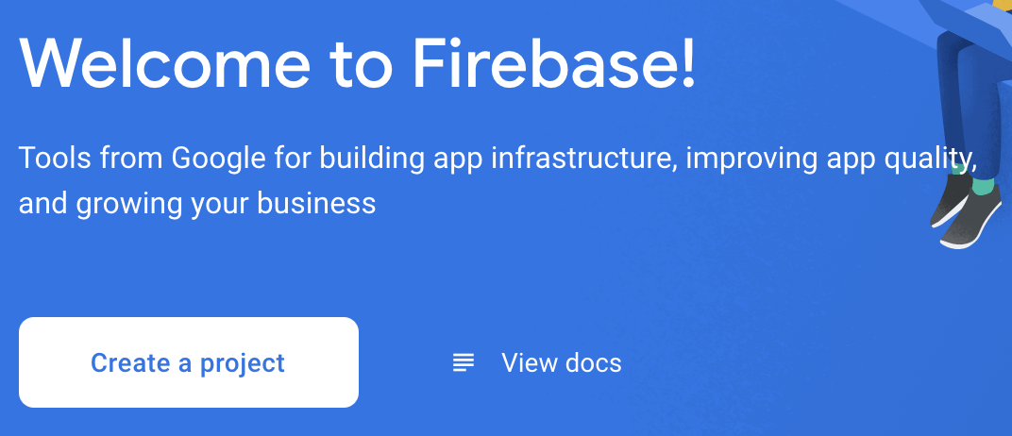
Create a Firebase project
In the Firebase console, click Add project, then select or enter a Project name.

Slide 118
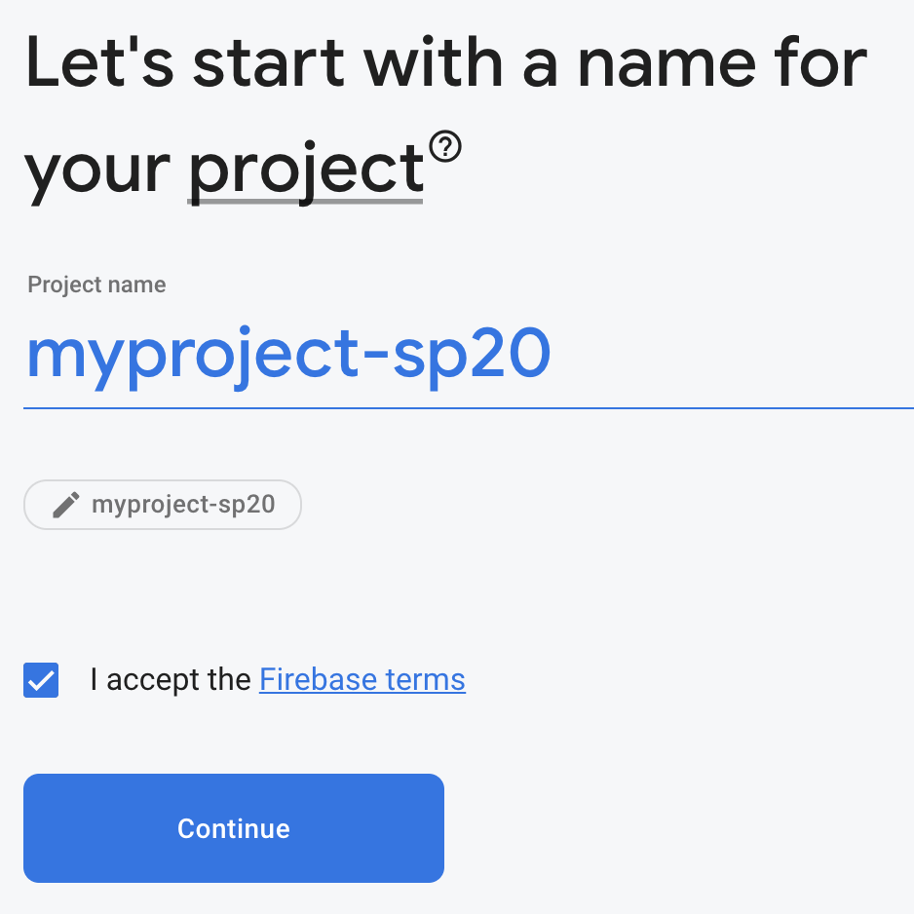
https://console.firebase.google.com/u/0/

Slide 119
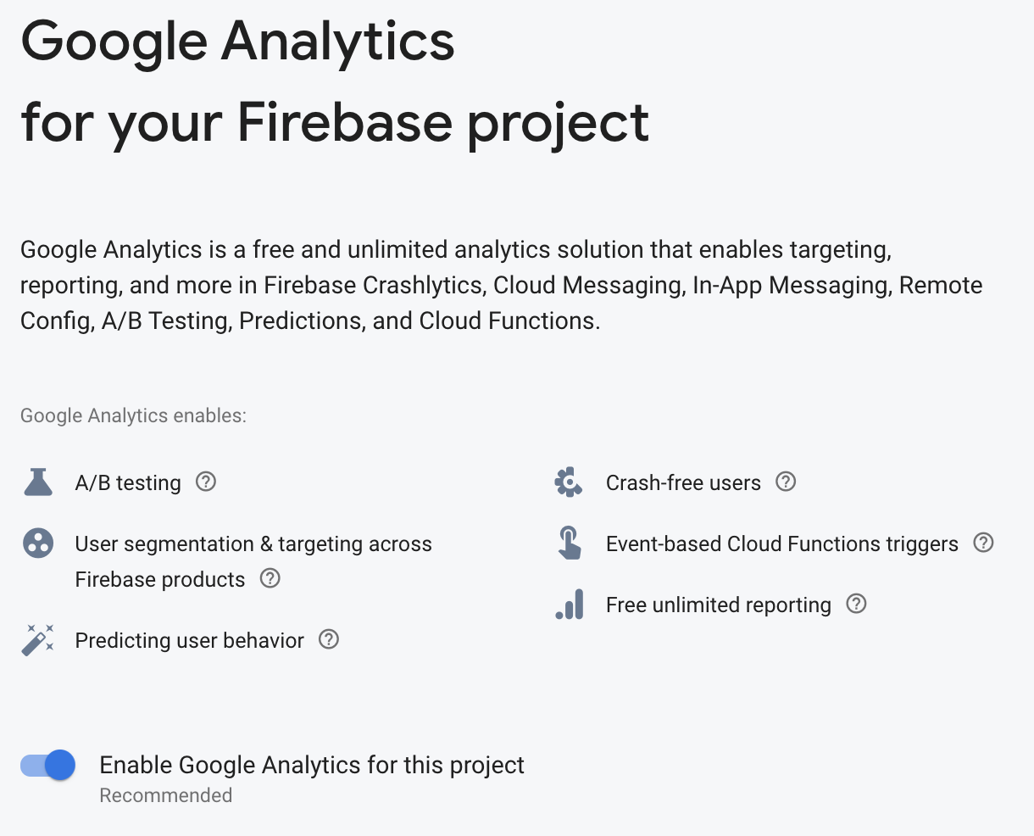
Enable Google Analytics

Slide 120
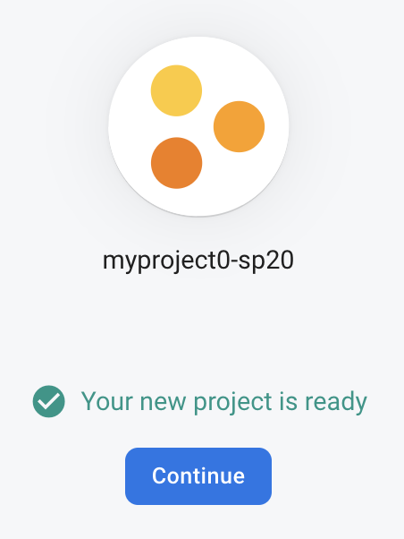
Done
Firebase automatically provisions resources for your Firebase project.
When the process completes, you'll be taken to the overview page for your Firebase project in the Firebase console.

Slide 121
Add Firebase to your JavaScript project
Step 2: Register your app with Firebase

Slide 122

Register your app with Firebase
After you have a Firebase project, you can add your web app to it.
In the center of the Firebase console's project overview page, click the Web icon (plat_web) to launch the setup workflow.
Enter your app's nickname, an internal, convenience identifier and is only visible to you in the Firebase console.

Slide 124
SETTING UP
FIRESTORE
& NODE.JS

